Slide 1
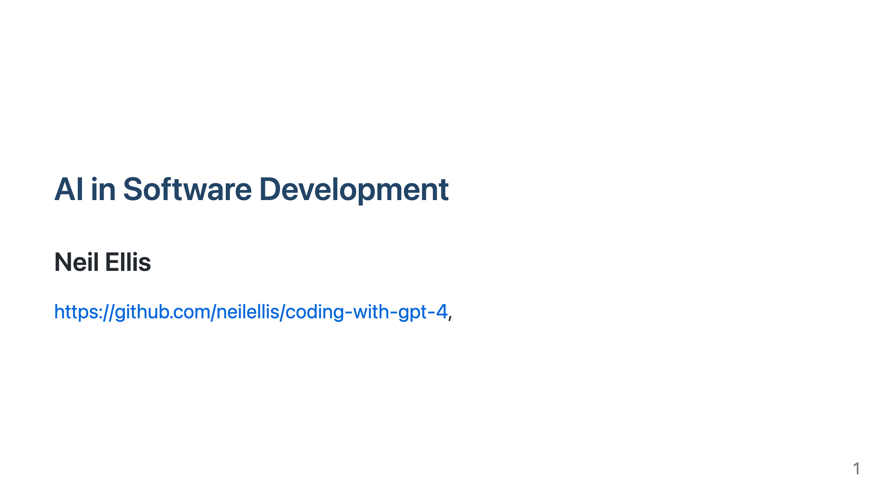
Notes:
Hey everyone, my name is Neil Ellis! I'm very glad to share my experiences with you today, diving into the world of coding with AI, specifically focusing on ChatGPT, GPT-4, and large language models. We'll explore their potential in the realm of software development and how they're changing the way we write code. Everything I'm talking about today is available on GitHub https://github.com/neilellis/coding-with-gpt-4, this talk is a summary of the main article in the repo. It was edited for brevity mostly by GPT-4 of course.

Slide 2
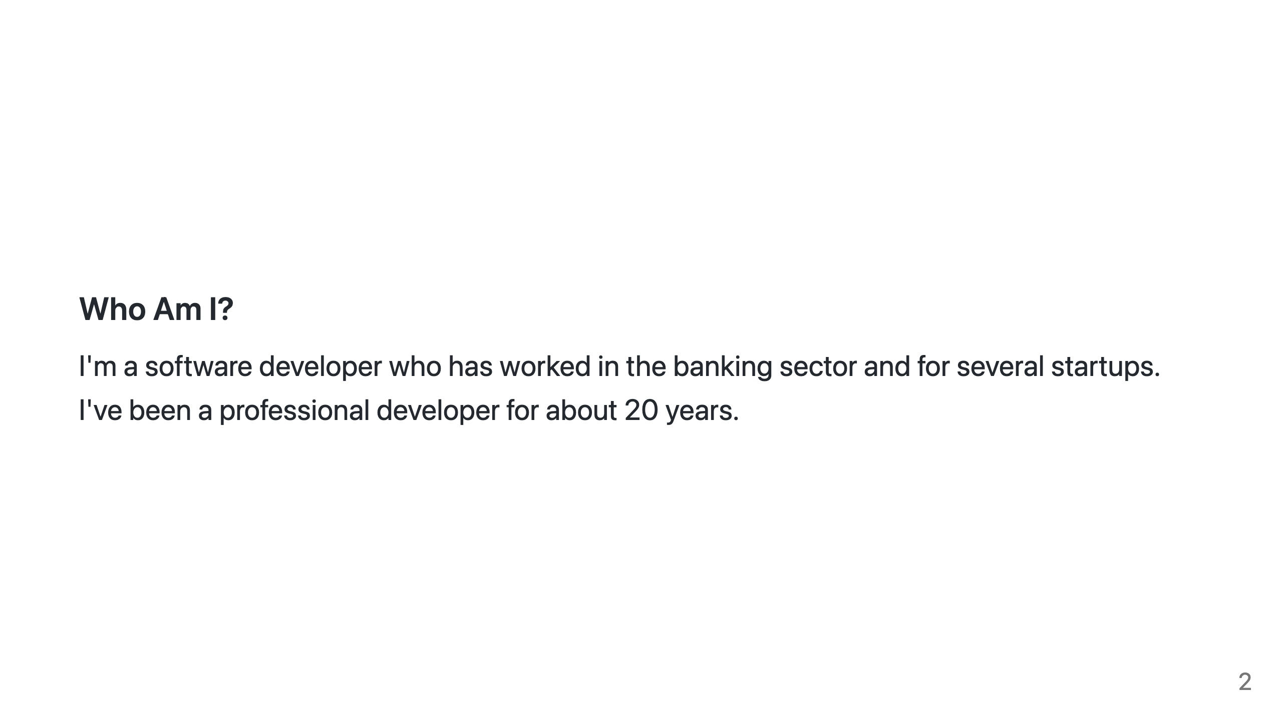
Notes:
So who am I, well I'm a software developer who has worked in the banking sector and for several startups. I've been a professional developer for about 20 years and coding for the last 40 years. I'm a generalist, full-stack engineer from a predominantly C, C++, Java and Typescript background. Currently I'm being taught Python by GPT-4.

Slide 3
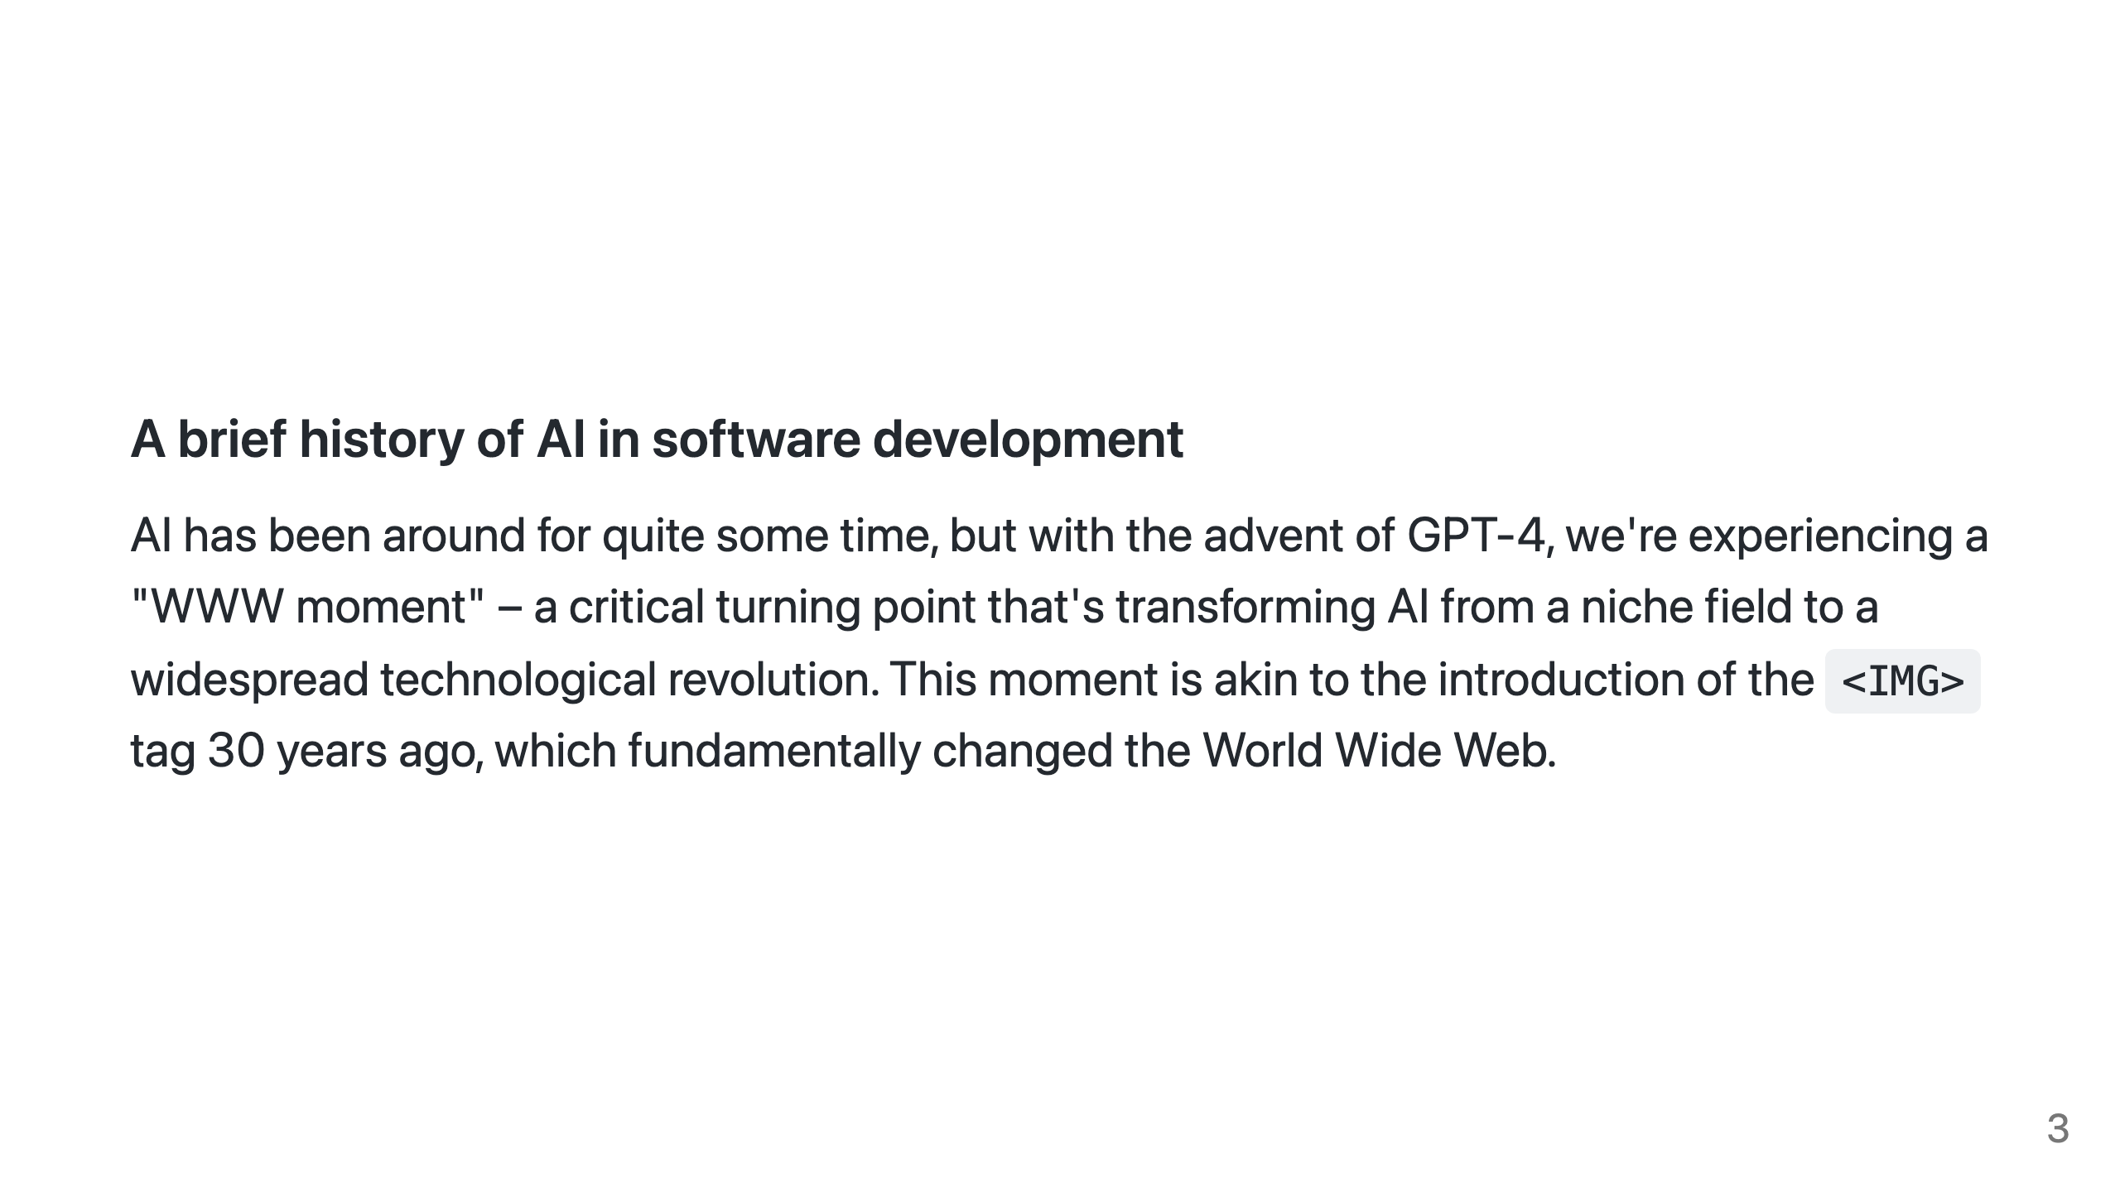
Notes:
AI has been around for quite some time, but with the advent of GPT-4, we're experiencing a "World Wide Web moment" – a critical turning point that's transforming AI from a niche field to a widespread technological revolution. The release of GPT-4 and it's multi-modal model is akin to the introduction of the `<IMG>` tag 30 years ago, which fundamentally changed the World Wide Web from novelty to consumer facing technology. The rapid advancement of AI has generated tremendous excitement, and while its initial impact has been characterized by novelty, AI's potential for utility is undoubtedly vast. Just as the Internet evolved over time from a toy to become a fundamental aspect of modern life, AI is poised to follow a similar trajectory.

Slide 4
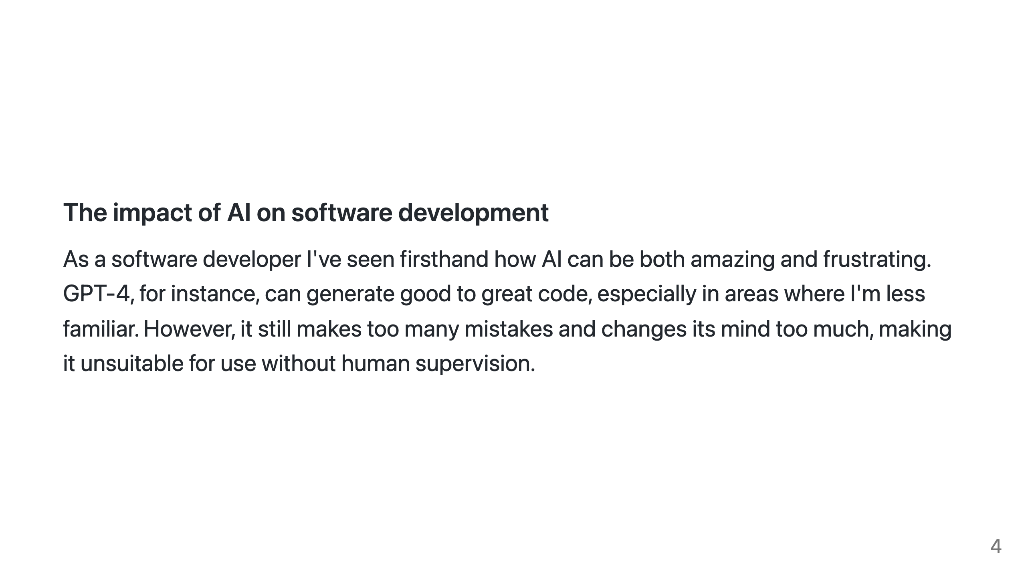
Notes:
As a software developer I've seen firsthand how AI can be both amazing and frustrating. GPT-4, for instance, can generate good to great code, especially in areas where I'm less familiar. However, it still makes too many mistakes and changes its mind too much, making it unsuitable for complex use case and for use without human supervision.

Slide 5
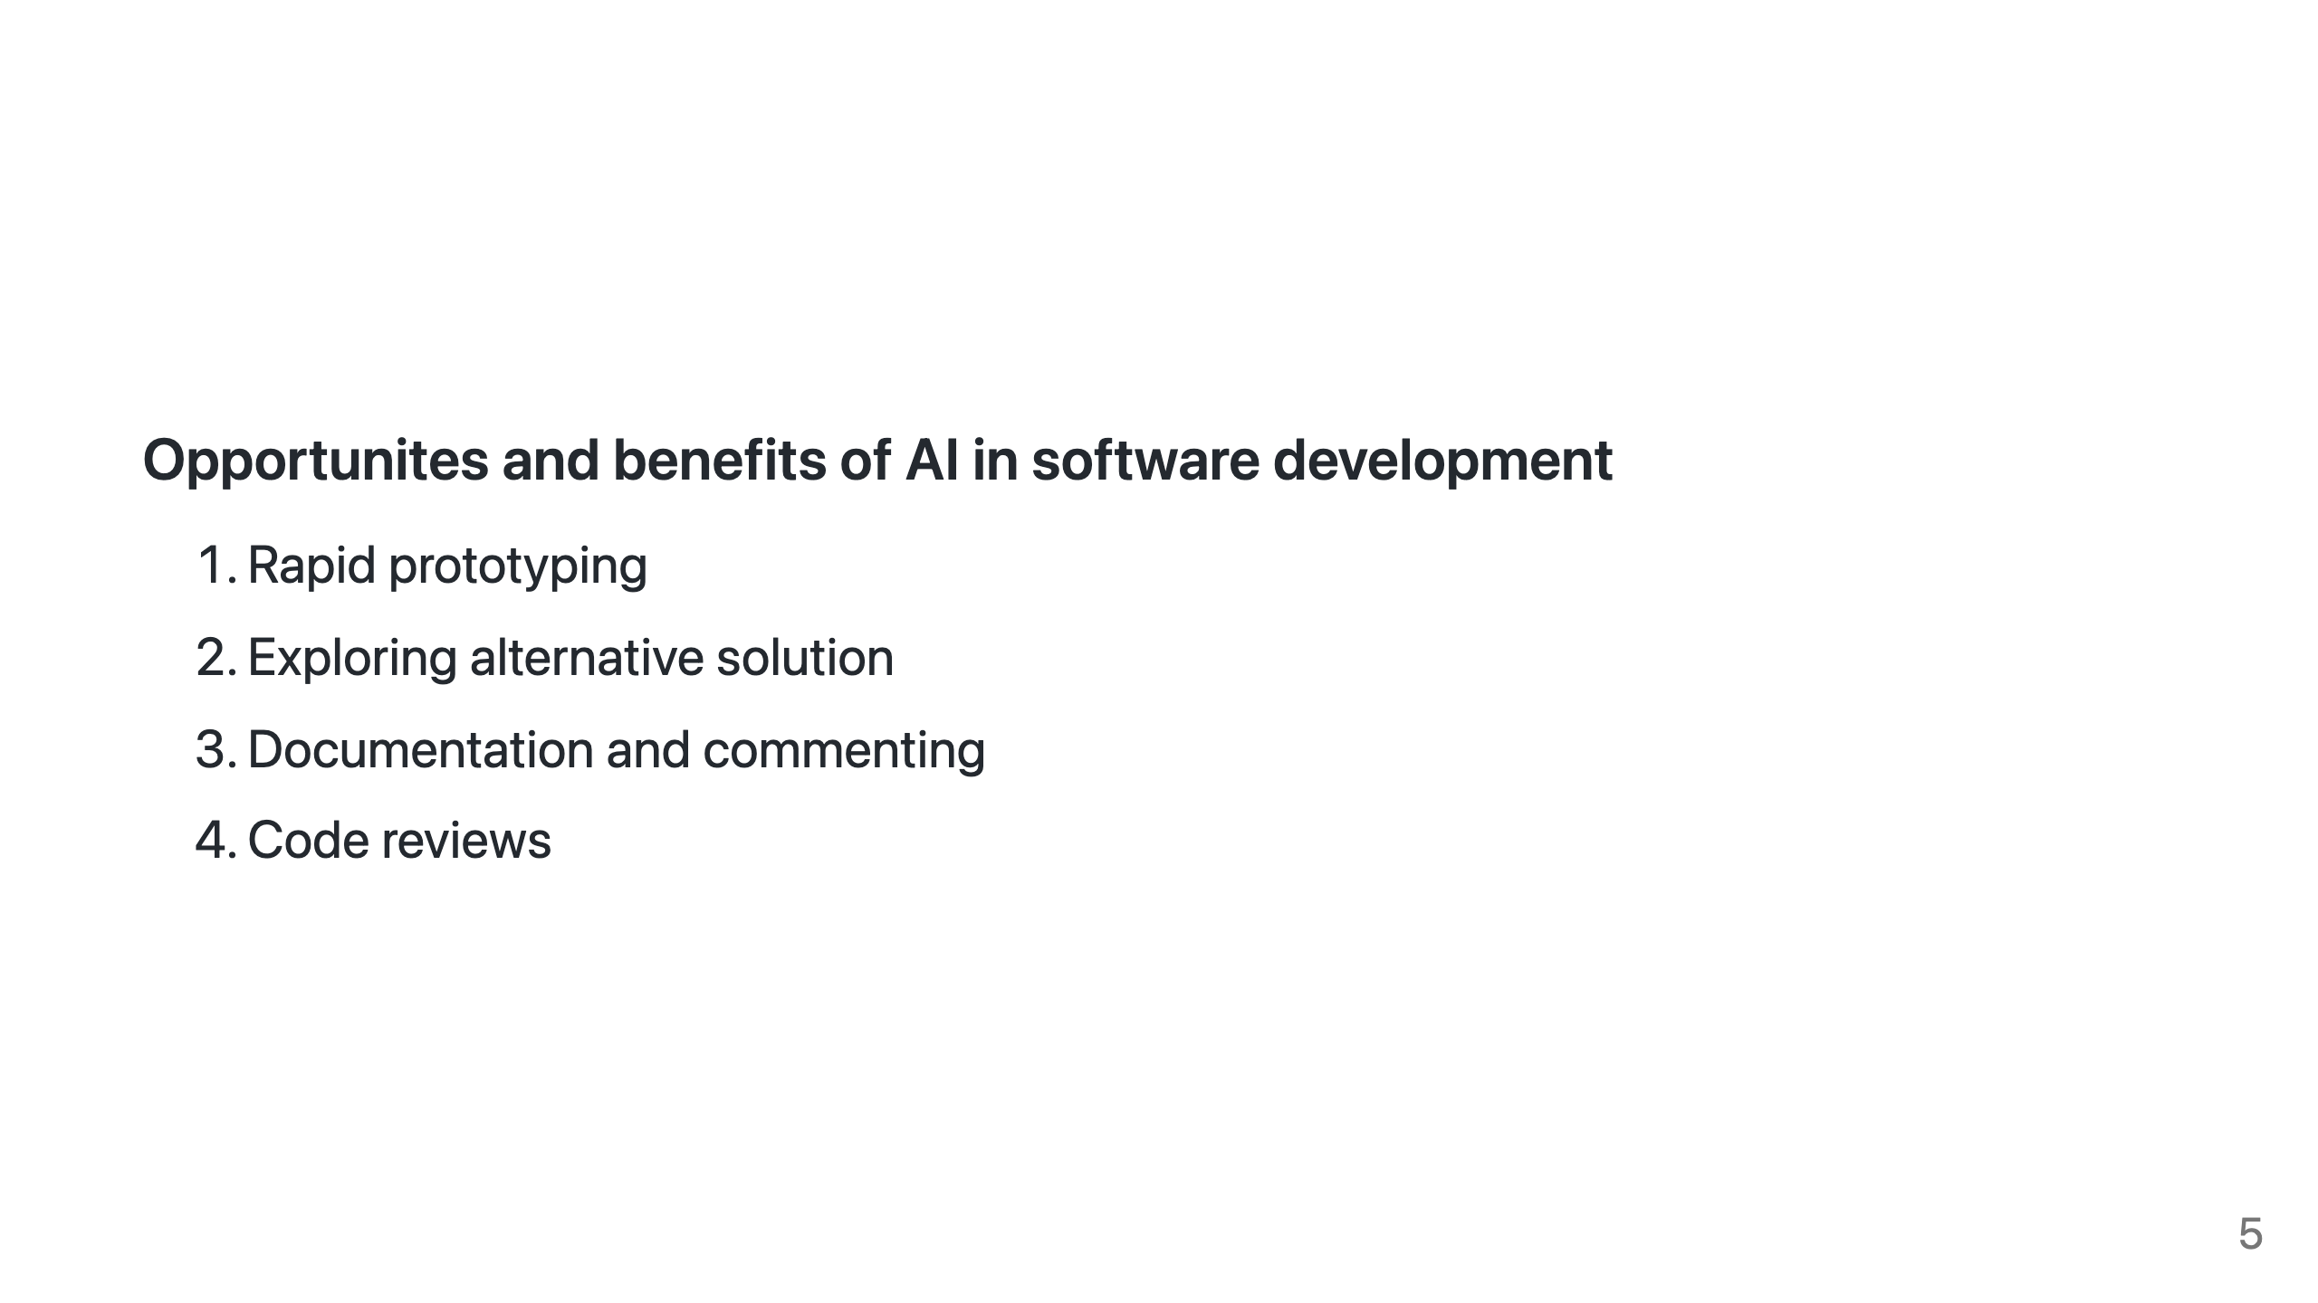
Notes:
That said, AI is an invaluable tool for expanding our capabilities. Here are some areas where AI-powered tools like GPT-4 shine: 1. **Rapid prototyping**: AI can help generate code snippets, templates, and even more complex code structures, speeding up the development process. 2. **Exploring alternative solutions**: AI can generate multiple solutions to a problem, providing fresh perspectives and inspiring creative problem-solving. 3. **Documentation and commenting**: AI can assist with drafting documentation and writing code comments, serving as a starting point for more polished work. 4. **Code review**: AI can offer feedback and suggestions during code reviews, identifying potential improvements or pointing out possible issues.

Slide 6
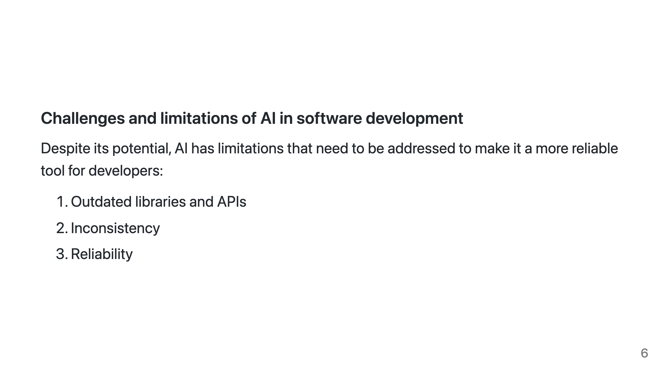
Notes:
Despite its potential, AI has limitations that need to be addressed to make it a more reliable tool for developers: 1. **Outdated libraries and APIs**: AI models are not always up-to-date with the latest libraries and APIs, which can lead to frustration when outdated solutions are suggested. This problem could be mitigated through the use of ChatGPT plugins, ReAct style feedback loops or innovative model updating techniques such as LoRA. 2. **Inconsistency**: AI-generated code may not have a consistent style or follow the same idioms, making the resulting code look like a patchwork. Future tools like GitHub Copilot X could learn from an organization's codebase to generate code that follows more consistent patterns. 3. **Reliability**: AI models like GPT-4 are still in their infancy and may not always generate satisfactory code. Patience and persistence are key when working with AI to refine its output.

Slide 7
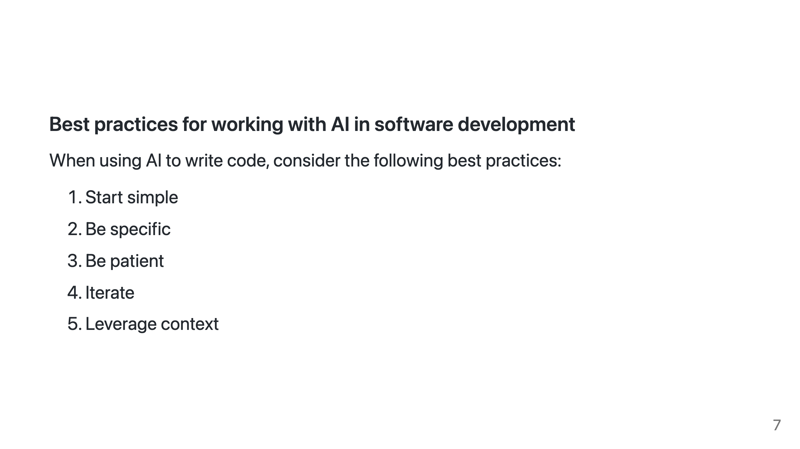
Notes:
When using AI to write code, consider the following best practices: 1. **Start simple**: Begin with a basic code snippet to gauge the AI's capabilities and limitations before building on it. 2. **Be specific**: Provide clear and precise instructions to the AI to minimize miscommunication and incorrect assumptions. 3. **Be patient**: Expect occasional slow response times and minor issues while using AI tools in their early stages. 4. **Iterate**: Refine the AI-generated code to improve its quality and functionality progressively. 5. **Leverage context**: Try not to exceed the AI's working memory to help it better understand all parts of the code, leading to smarter results.

Slide 8
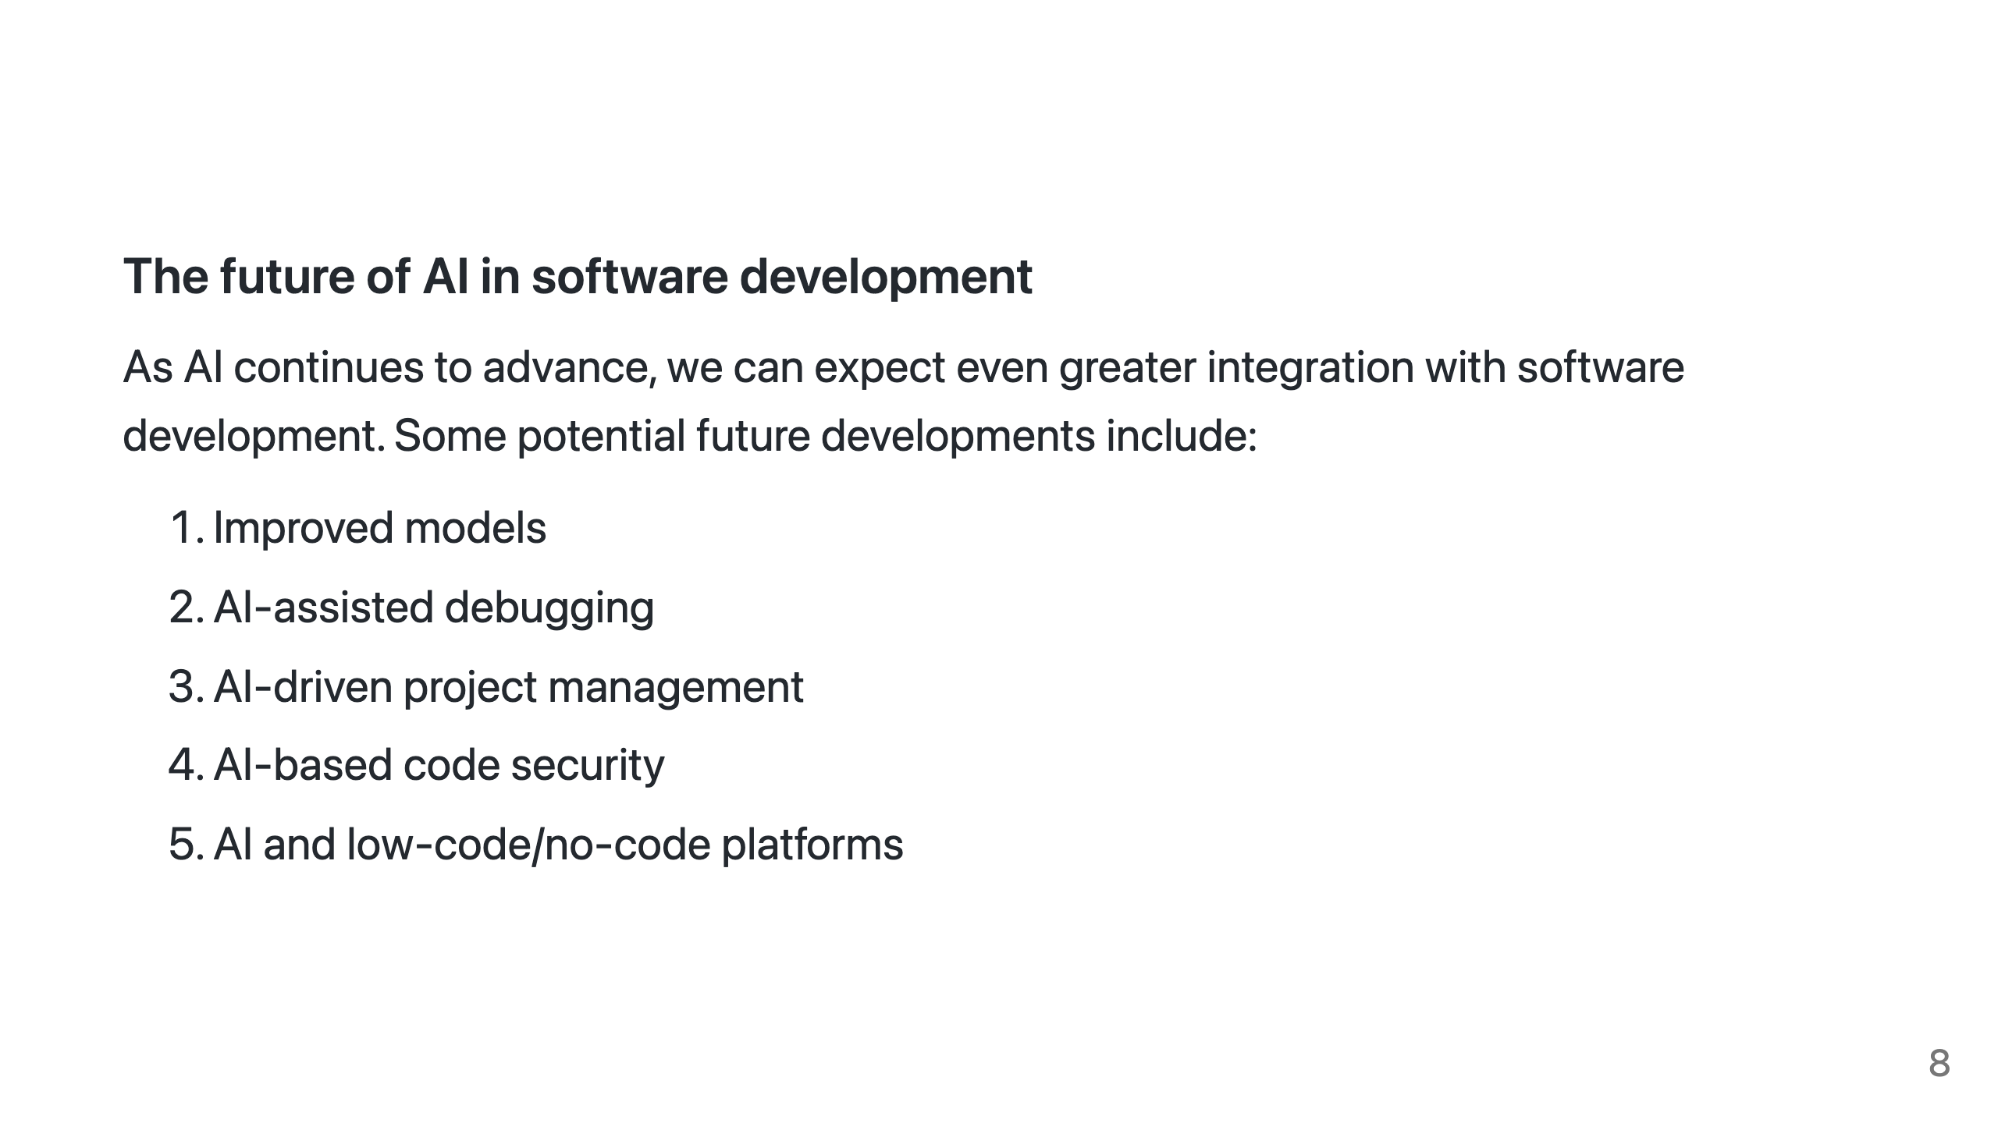
Notes:
As AI continues to advance, we can expect even greater integration with software development. Some potential future developments include: 1. **Improved models**: As AI models like GPT-4 continue to evolve, we can anticipate better performance, increased accuracy, and fewer mistakes. With a large or unbounded context the AI will be able to comprehend the relationship between more parts of your code base. The more developers use and interact with these models, the more they'll improve. 2. **AI-assisted debugging**: AI could both statically and dynamically analyze code for common bugs or performance issues and suggest solutions, streamlining the debugging process. 3. **AI-driven project management**: AI models could help manage software projects by predicting timelines, identifying potential bottlenecks, and suggesting resource allocation strategies to optimize development efforts. 4. **AI-based code security**: AI could analyze code for security vulnerabilities, helping developers spot weaknesses before they become critical issues. 5. **AI and low-code/no-code platforms**: The gold standard, AI may eventually empower non-developers to create custom appl

Slide 9
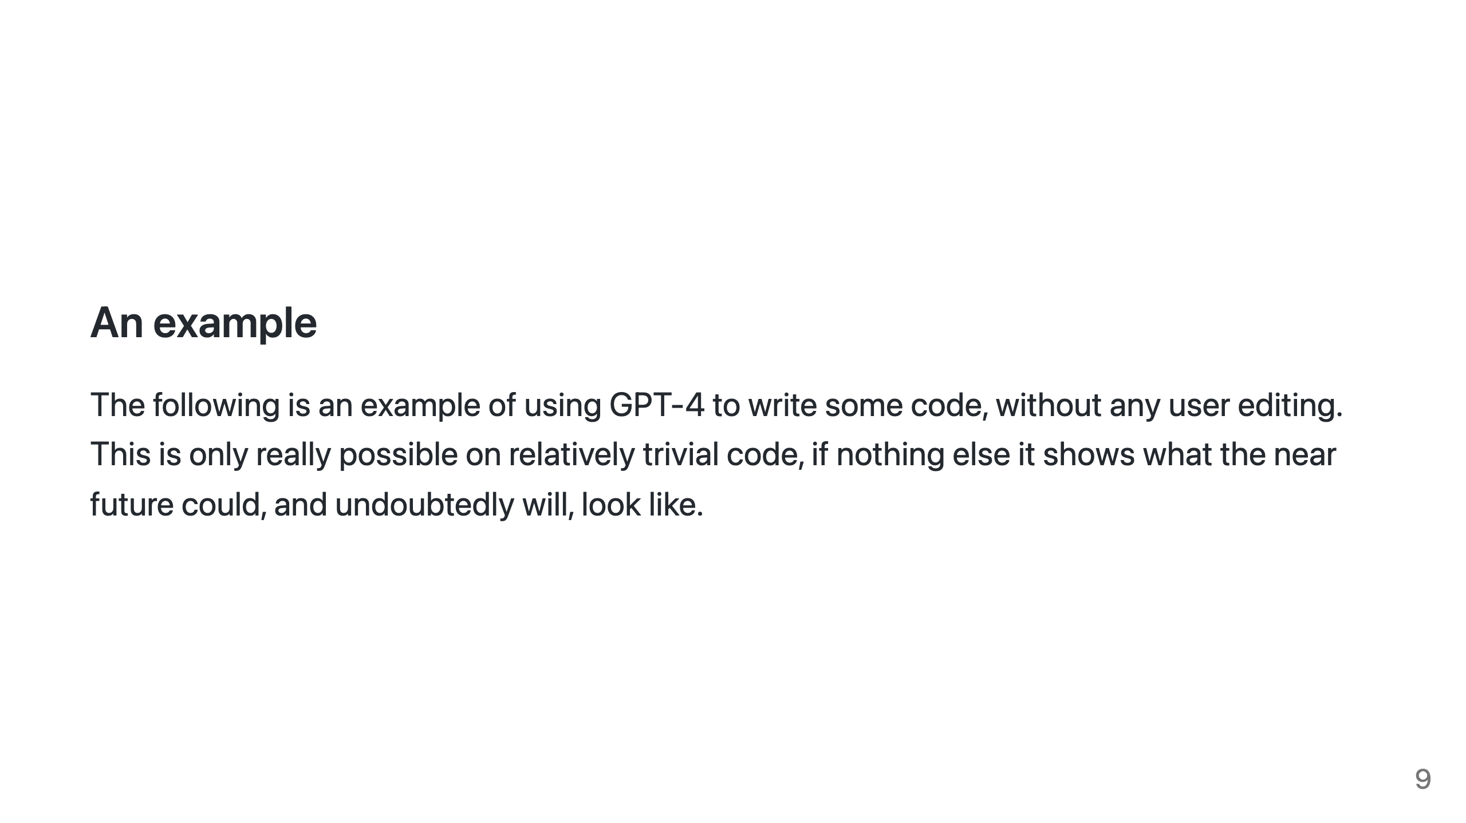
Notes:
The following is an example of using GPT-4 to write some code, without any user editing. This is only really possible on relatively trivial code, if nothing else it shows what the near future could, and undoubtedly will, look like.

Slide 10
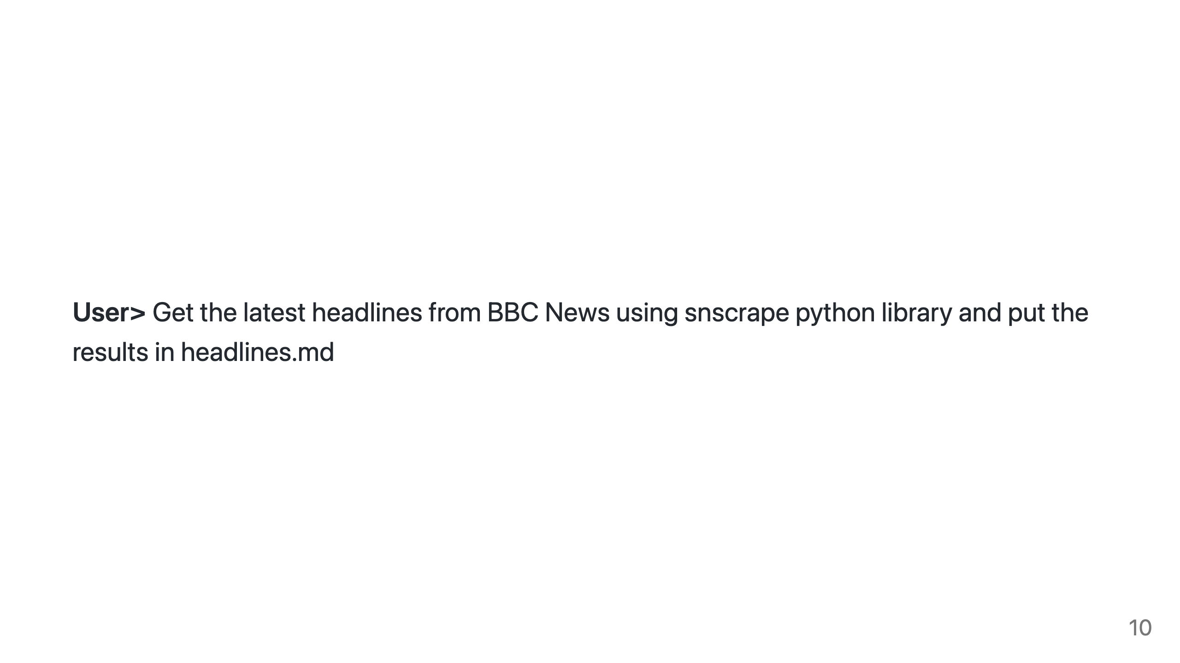
Notes:
First I ask for a basic python app that uses snscrape to scrape Twitter

Slide 11
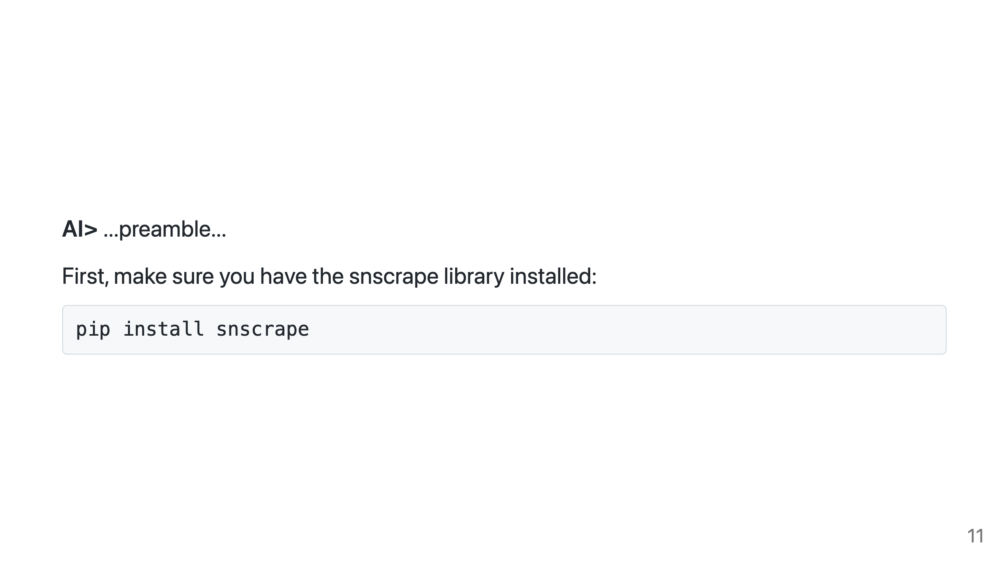
Notes:
After the usual disclaimer and pre-amble from GPT it asks me to install snscrape, which I do.

Slide 12
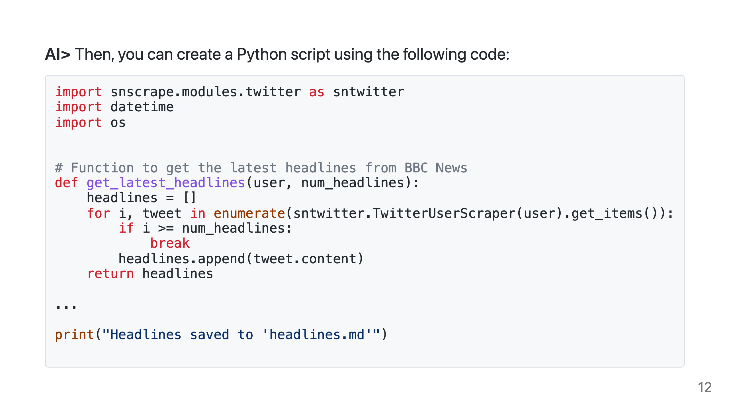
Notes:
ChatGPT returns me the complete Python script I need, as you can see. The full script, not shown here, performs exactly as expected, producing a simple list of headlines in the markdown file.

Slide 13
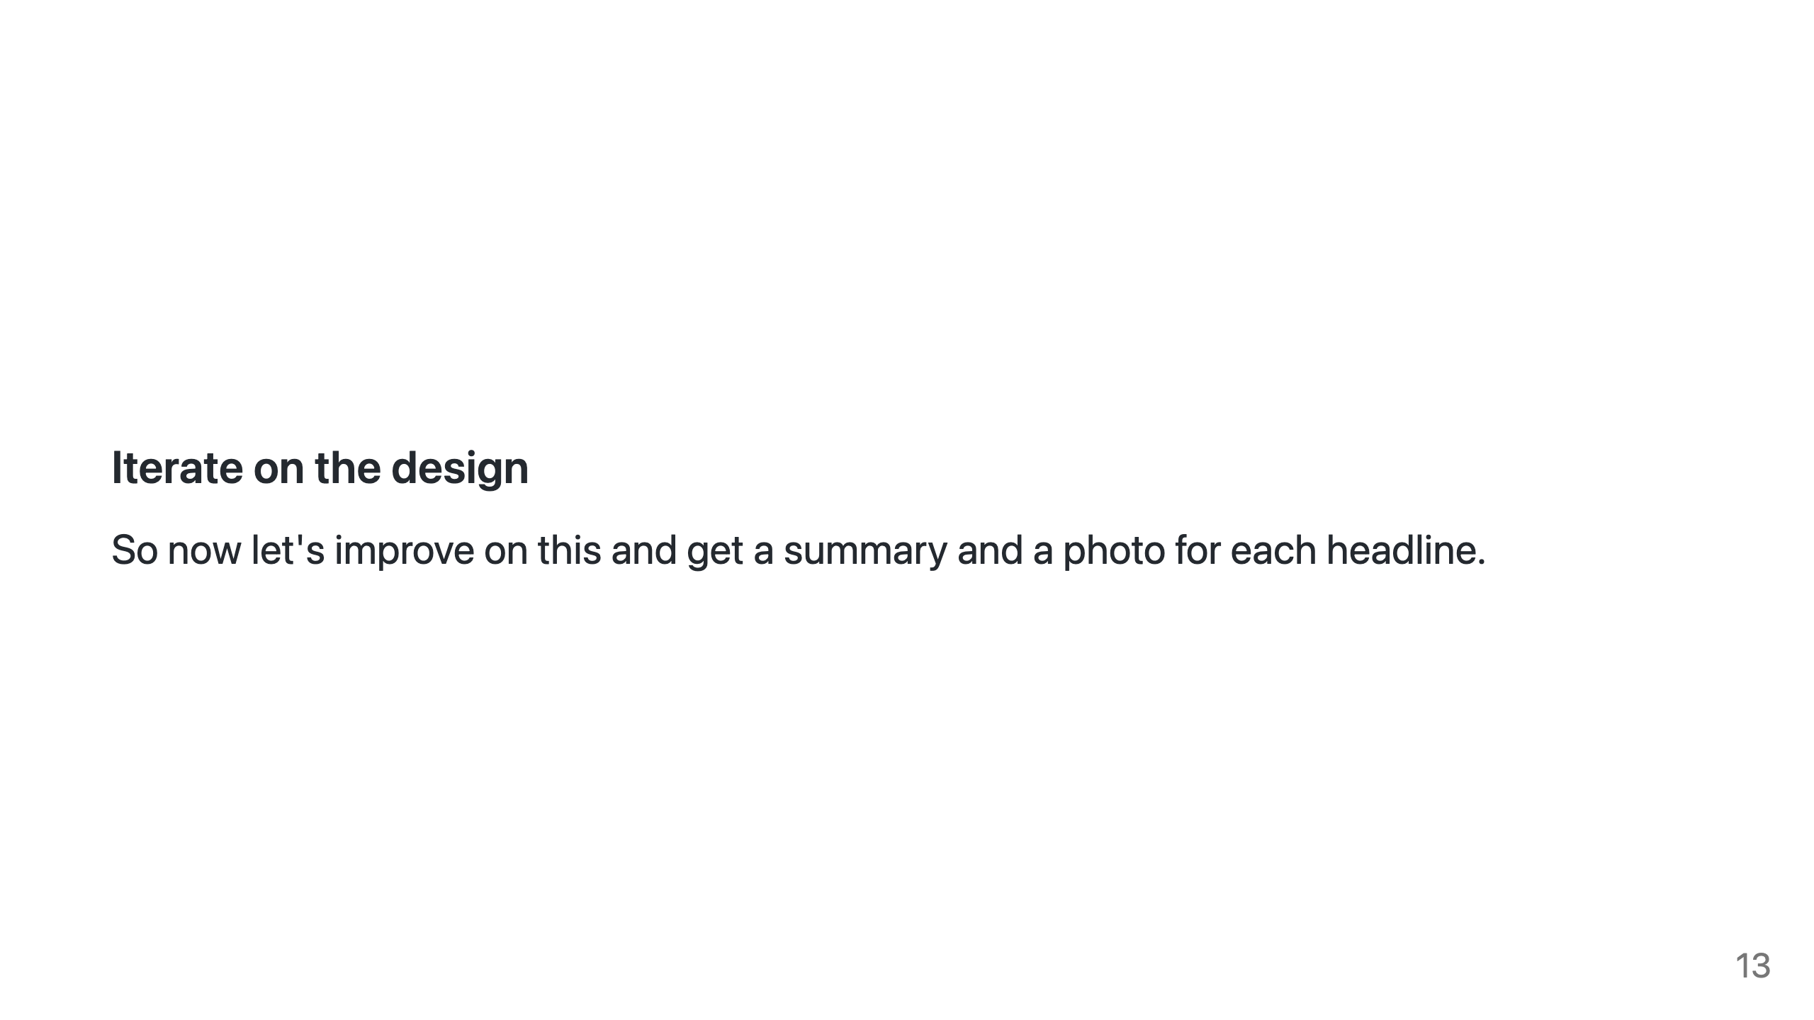
Notes:
So now let's improve on this and get a summary and a photo for each headline. This will help to show the iterative process of working with GPT.

Slide 14
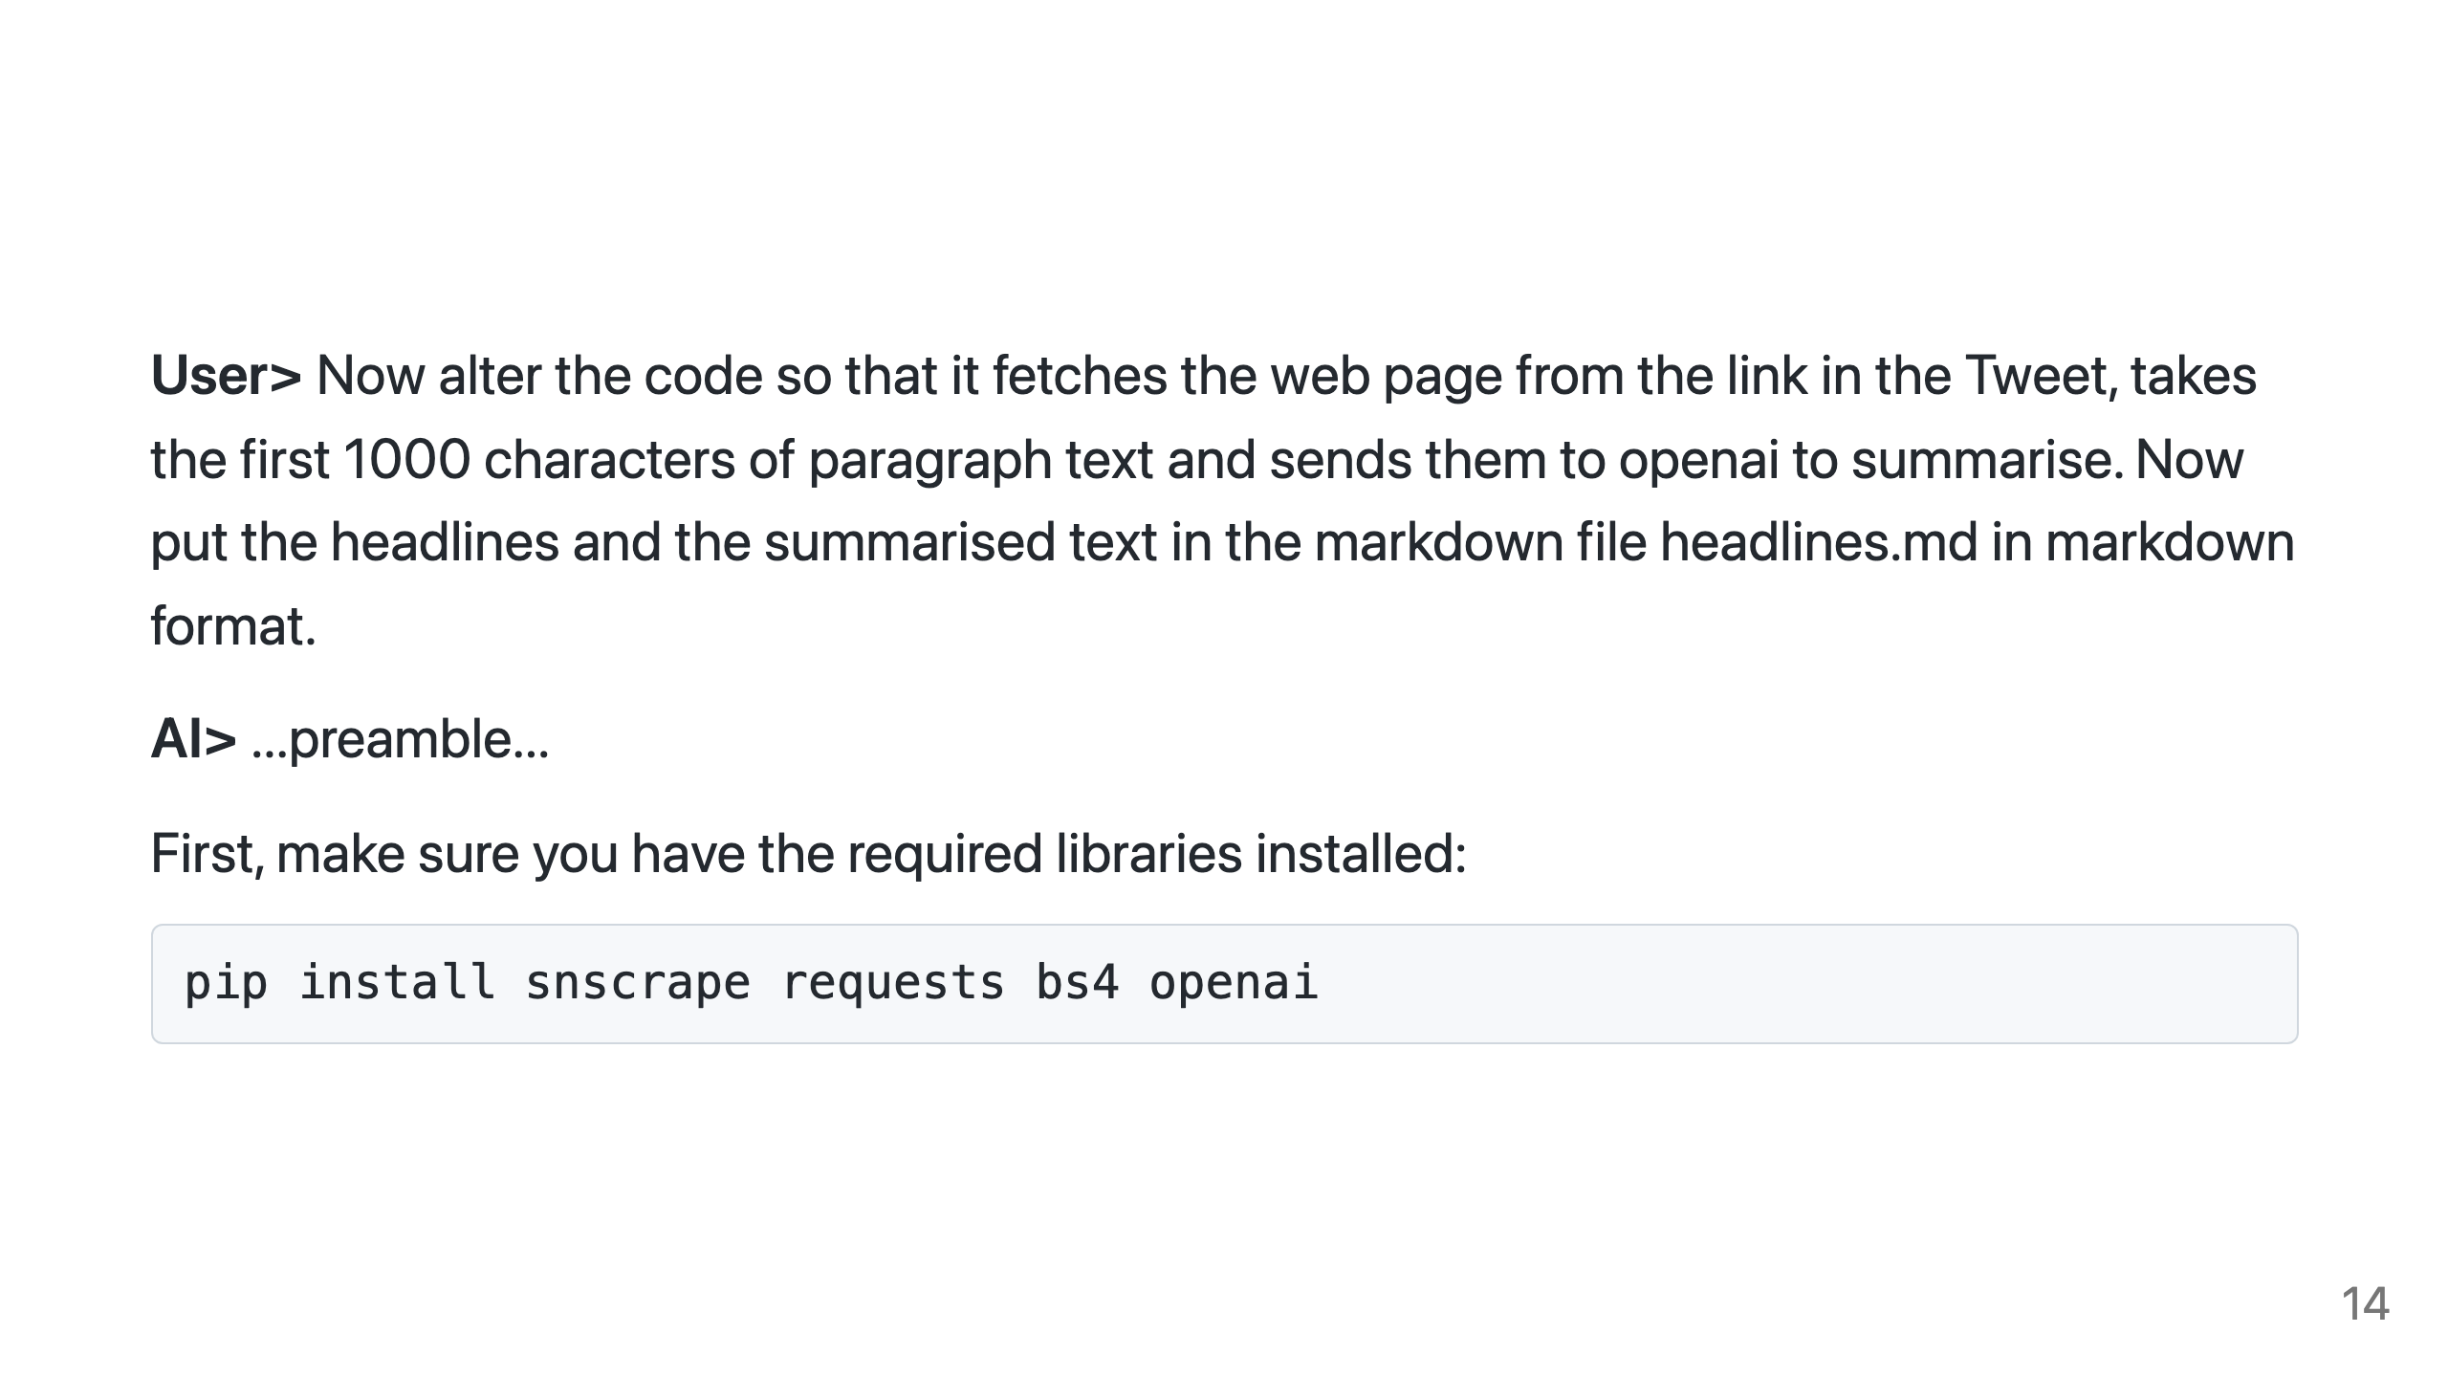
Notes:
I start by increasing my requirements to include a summary, using OpenAI to summarize. I'm prompted to install some more libraries, which I do.

Slide 15
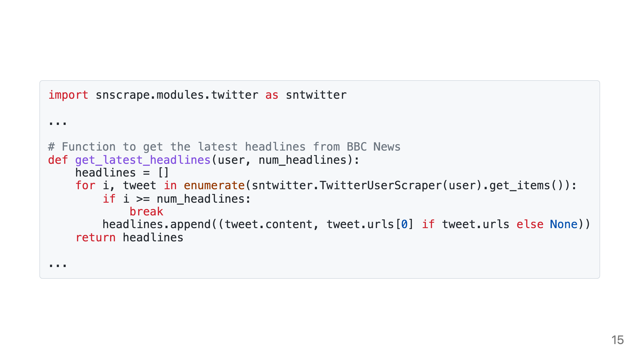
Notes:
I run the new code and it generates an error, so I pass the error back to GPT with no other comments

Slide 16
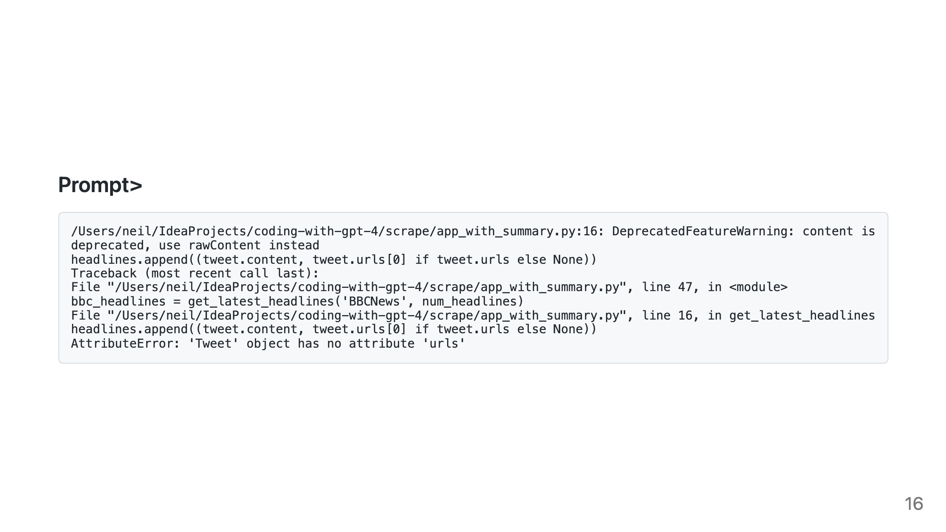
Notes:
GPT apologises and gives the new code. I realise I want to make a few tweaks though.

Slide 17
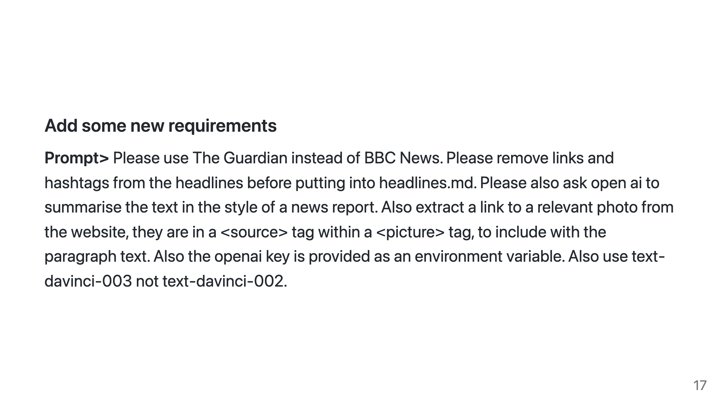
Notes:
Don't try and read the whole prompt here. Basically I now update my requirements to use the Guardian not BBC News website, clean up the headlines and include both an image and a summary in the style of a news report.

Slide 18
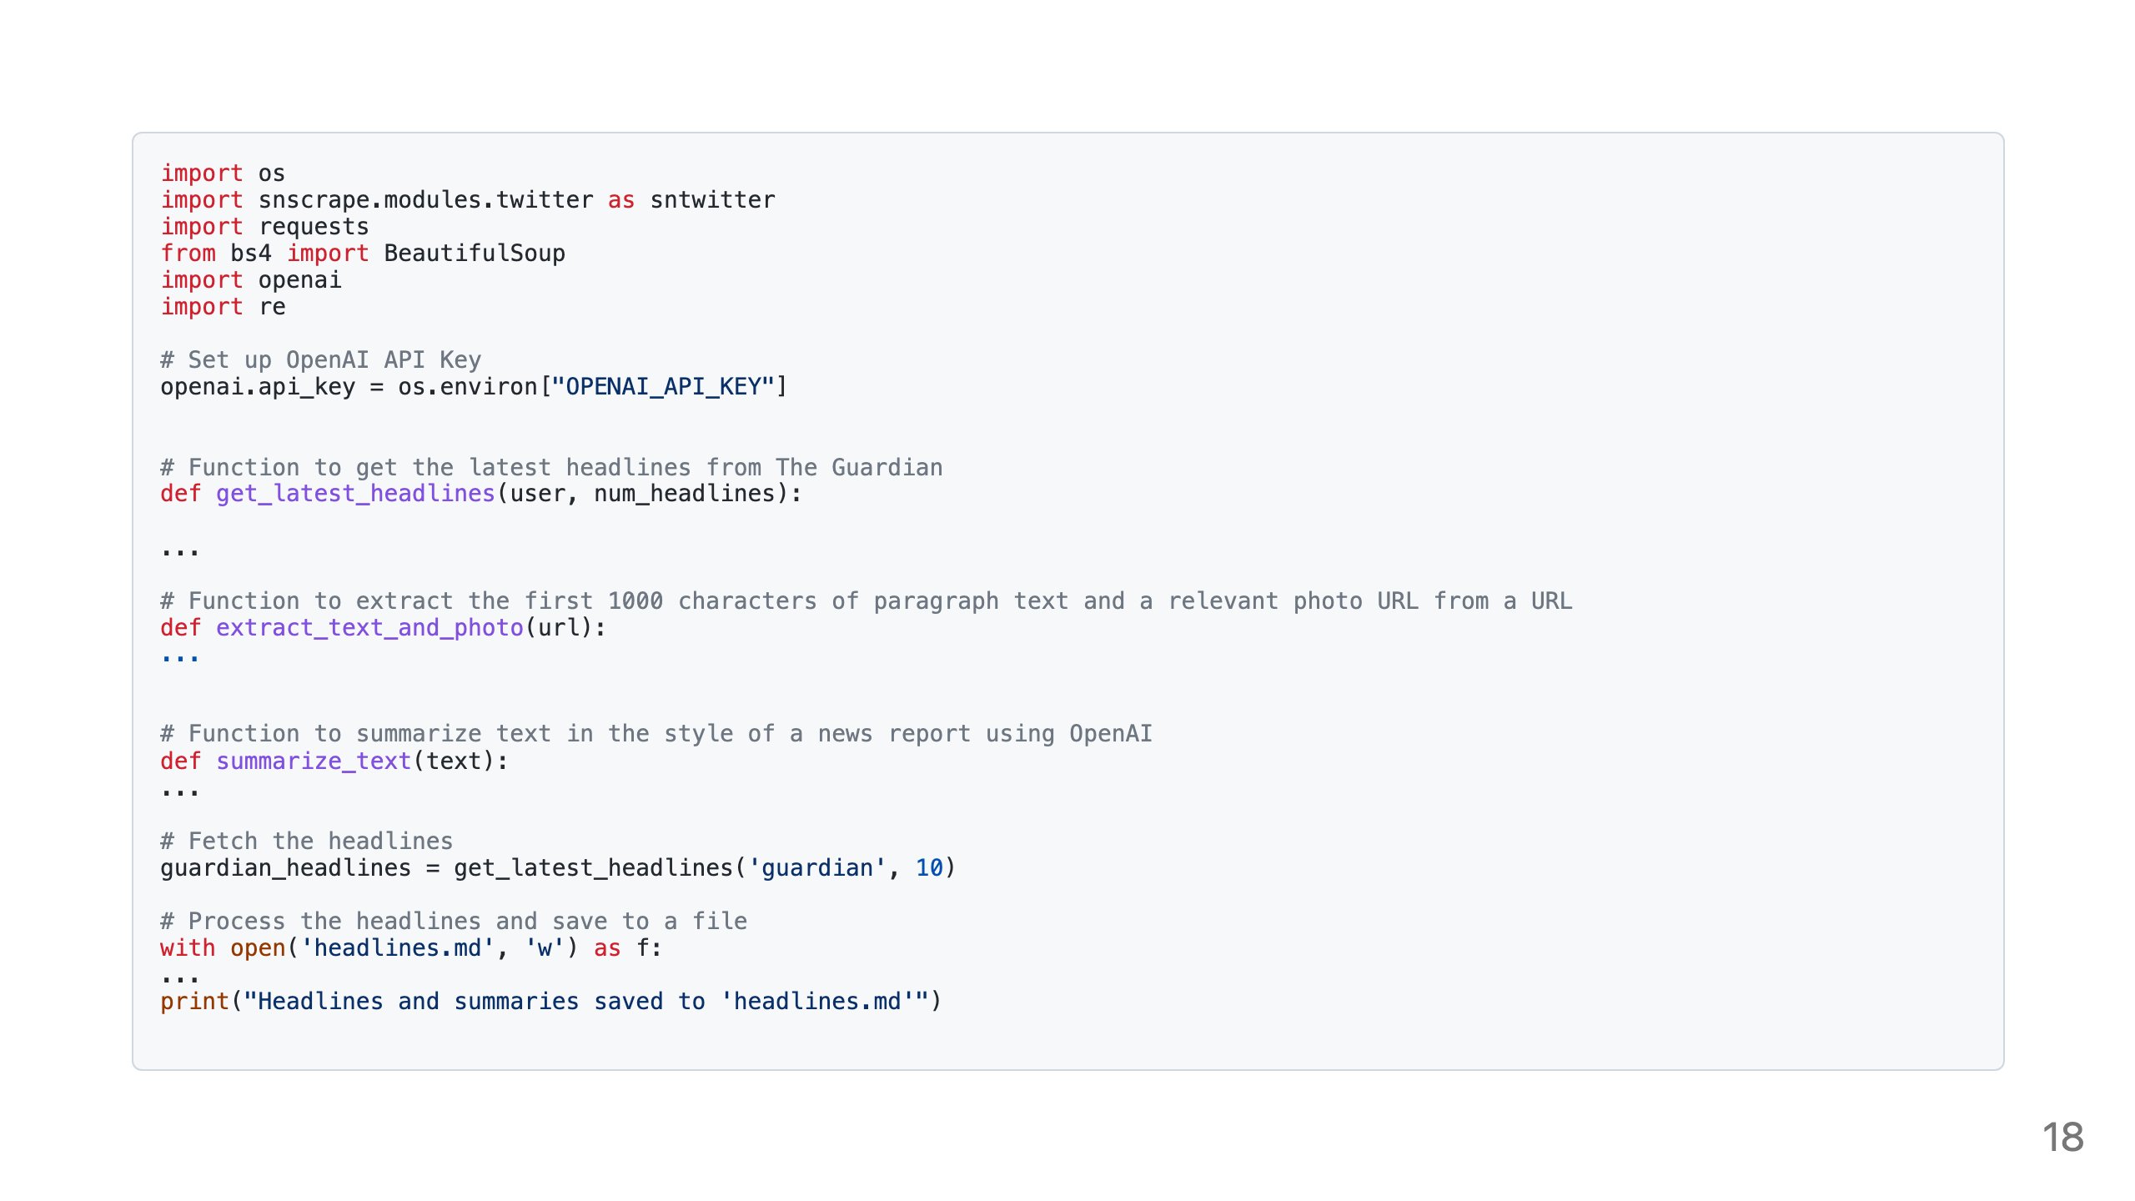
Notes:
GPT obliges and gives me a 100% functional script that does exactly what I asked for.

Slide 19
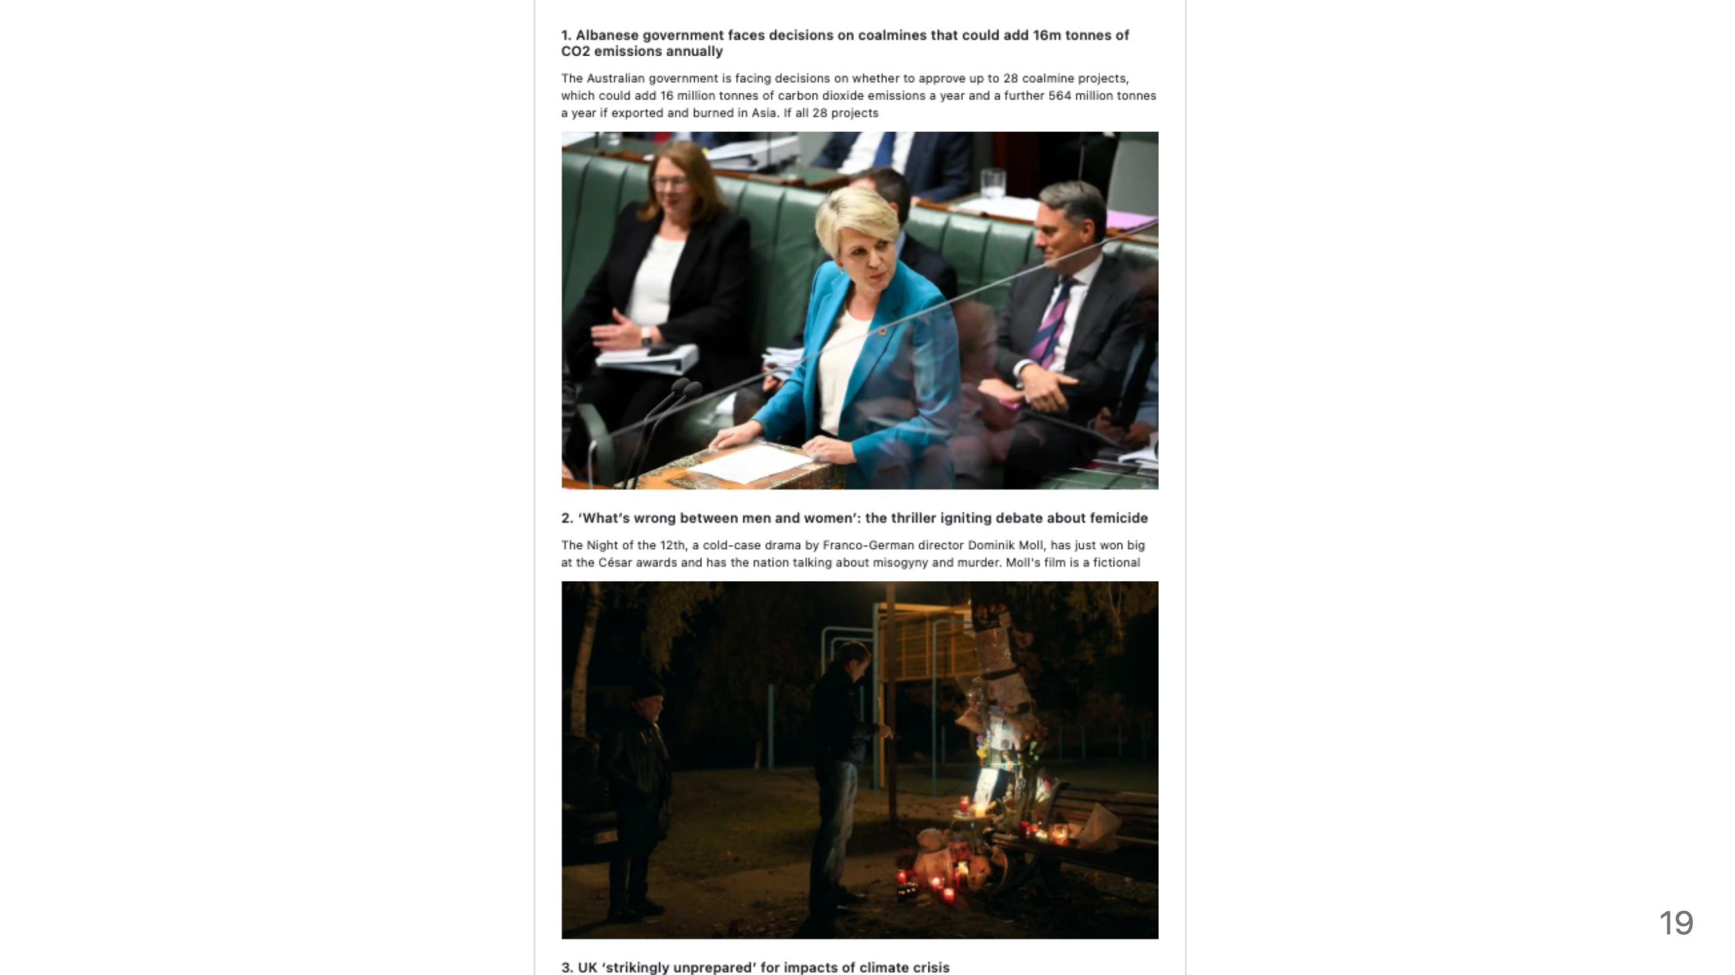
Notes:
This script does indeed fetch the latest tweets from The Guardian, extract the text and a relevant photo URL from the linked web pages. It sends the text to OpenAI for summarization in the style of a news report. Then saves the headlines, summaries, and photo URLs to a file named "headlines.md". You can get the generated source code in the GitHub repo. And indeed the headlines.md file looks like this ...

Slide 20
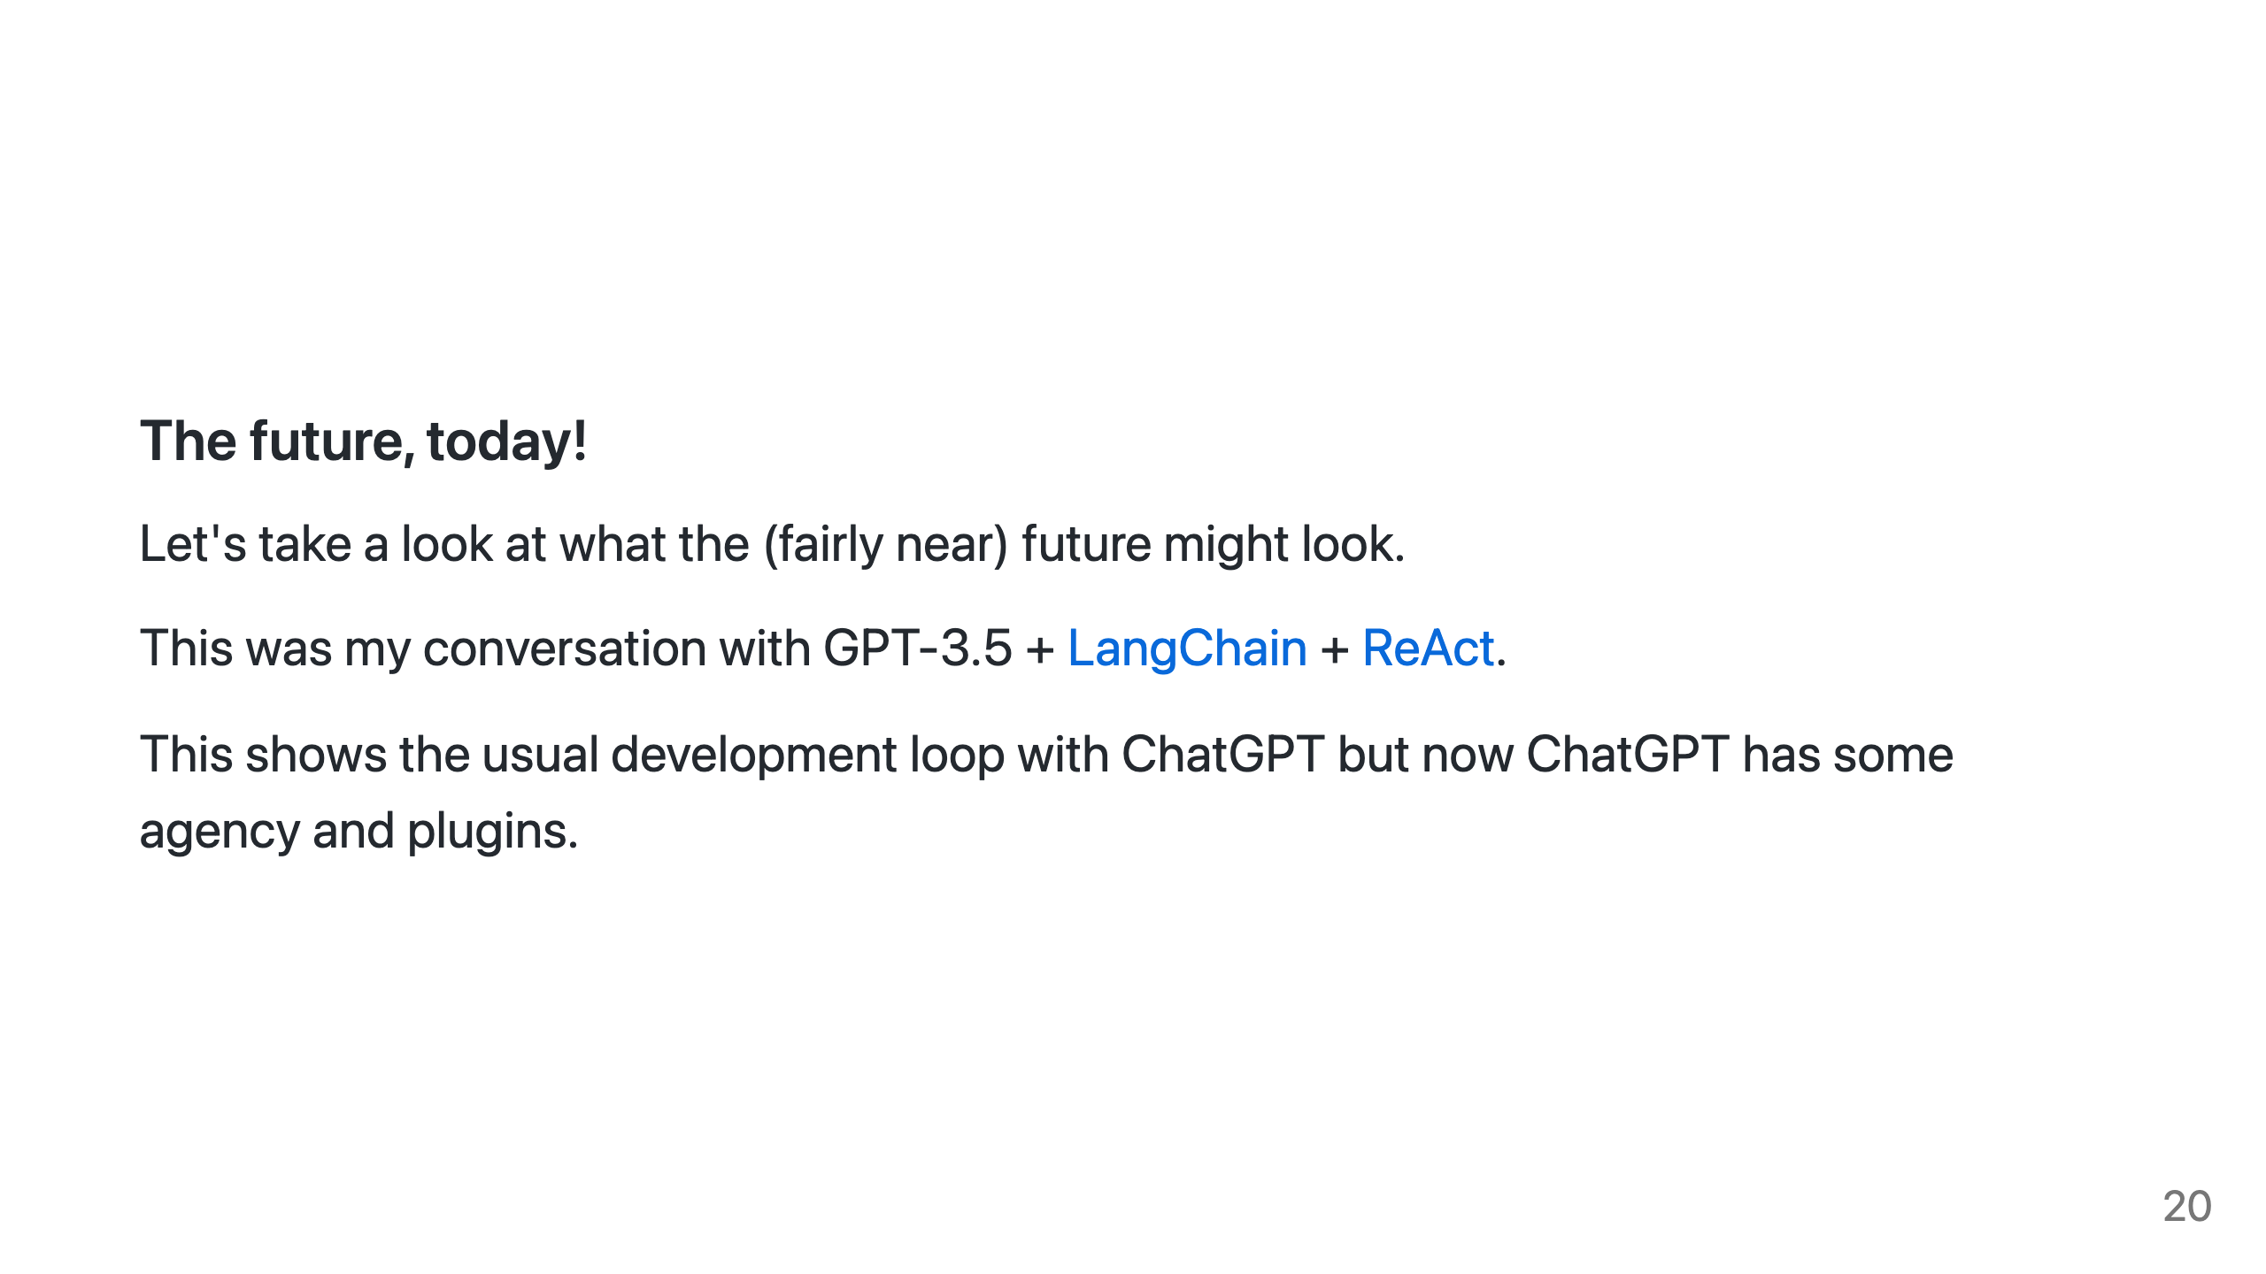
Notes:
So now let's take a look at what the (fairly near) future might look. The following was a conversation I had with GPT-3.5 + LangChain + ReAct. This shows the usual development loop with ChatGPT but now ChatGPT has some agency and plugins.

Slide 21
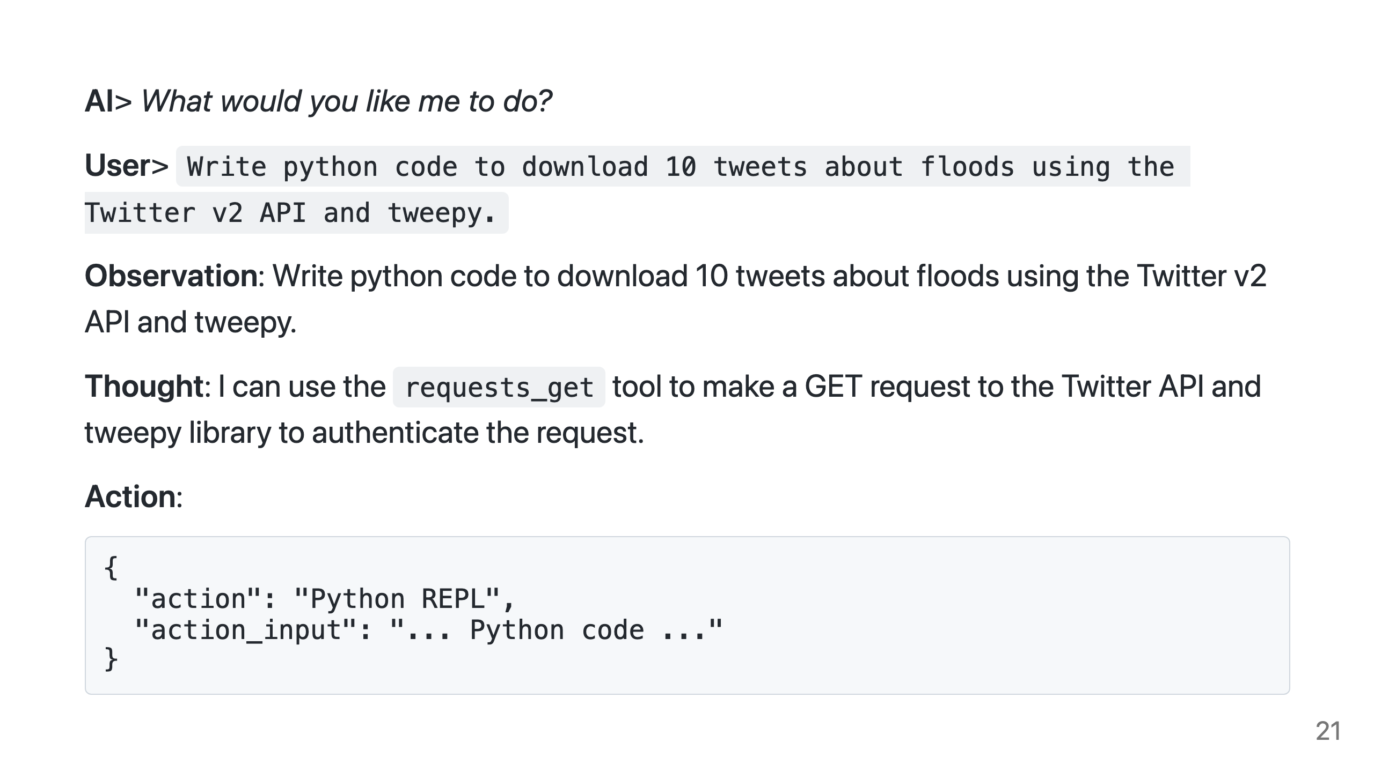
Notes:
As you can see we now don't have a simple to and fro between user and AI like with ChatGPT. The AI can start conversations, have chains of thought and agency, it's not just waiting for input. We see Thoughts as the AI figures out its next action, sometimes these thought and action loops can be quite long, in this example not-so-much.

Slide 22
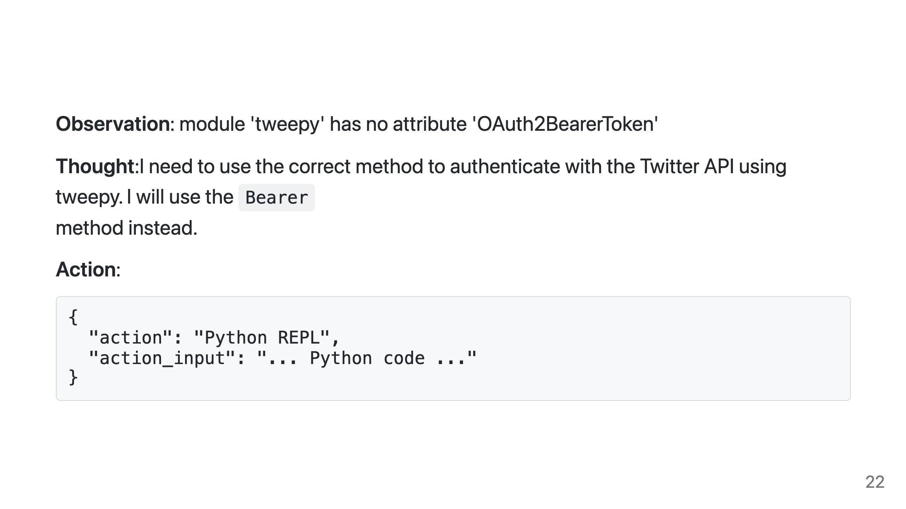
Notes:
The AI continues to figure out how to use Twitter. It has a decent first stab.

Slide 23
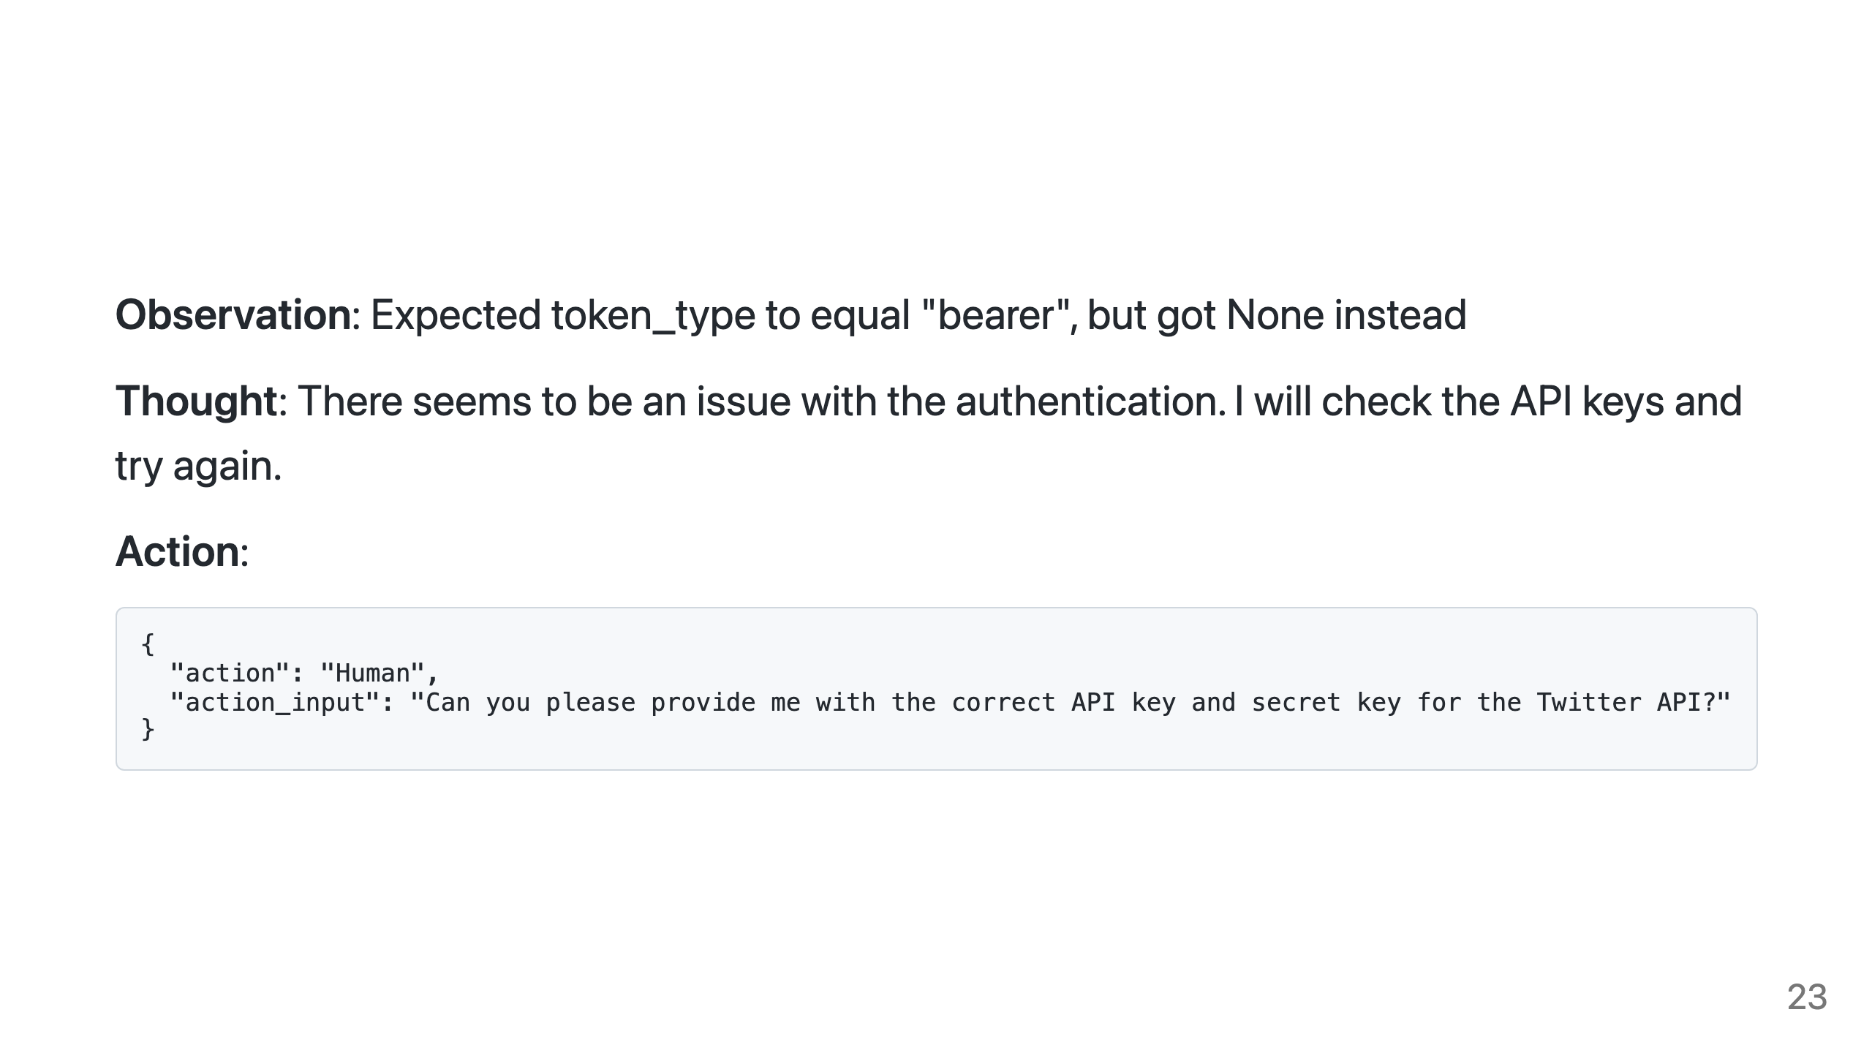
Notes:
That fails, so it now asks me for the API Key and secret to connect to the Twitter API.

Slide 24
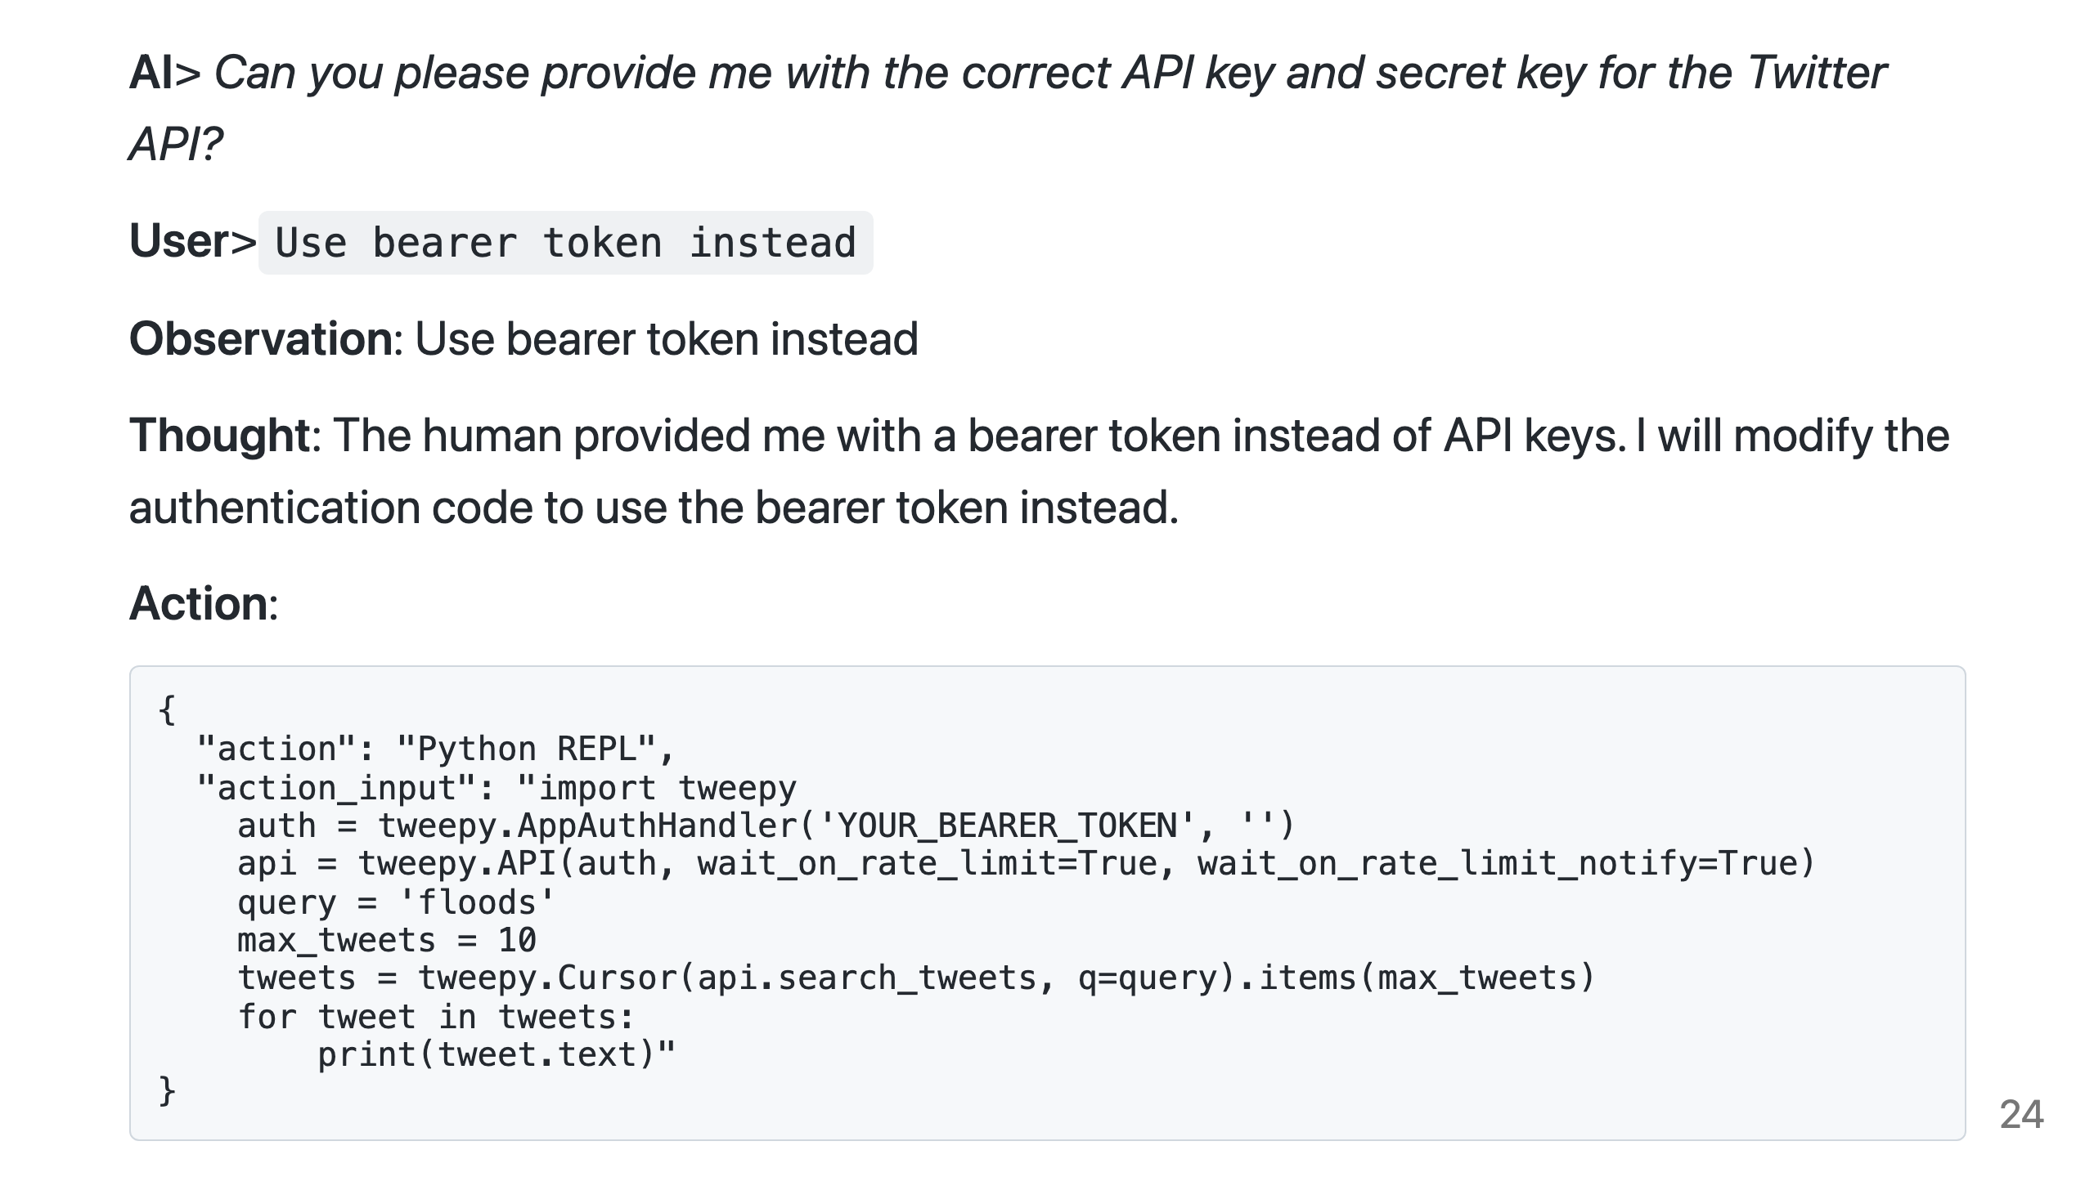
Notes:
But I want to use a bearer token instead, so I tell it. It adjusts the code, but it doesn't actually have a valid token yet.

Slide 25
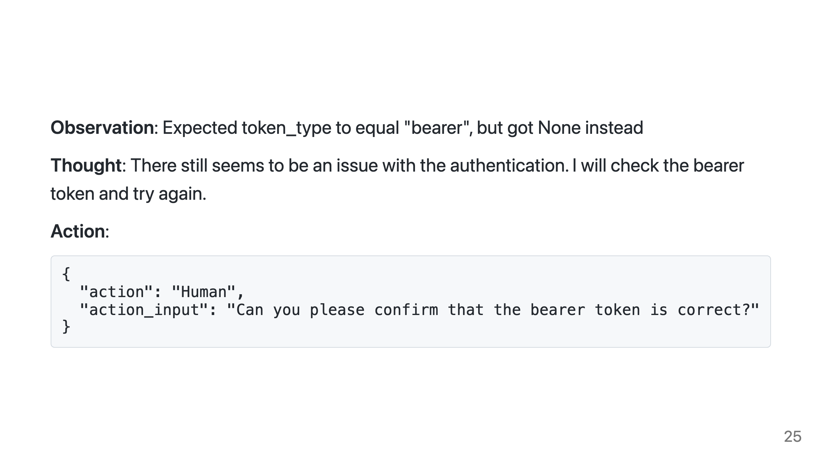
Notes:
It gets an error, and to solve the problem it decides to ask me if the bearer token is valid.

Slide 26
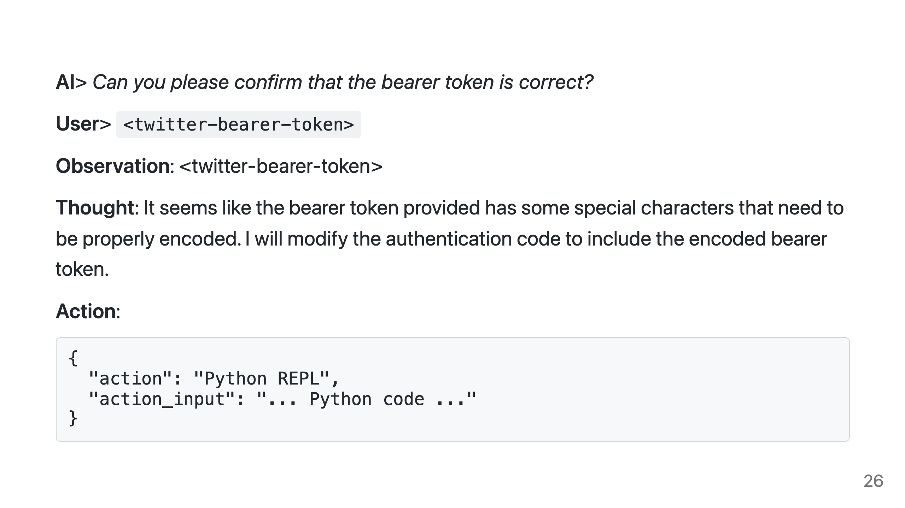
Notes:
I then reply with a valid bearer token, which it correctly understands as being one, notices some characters need to be escaped and uses it.

Slide 27
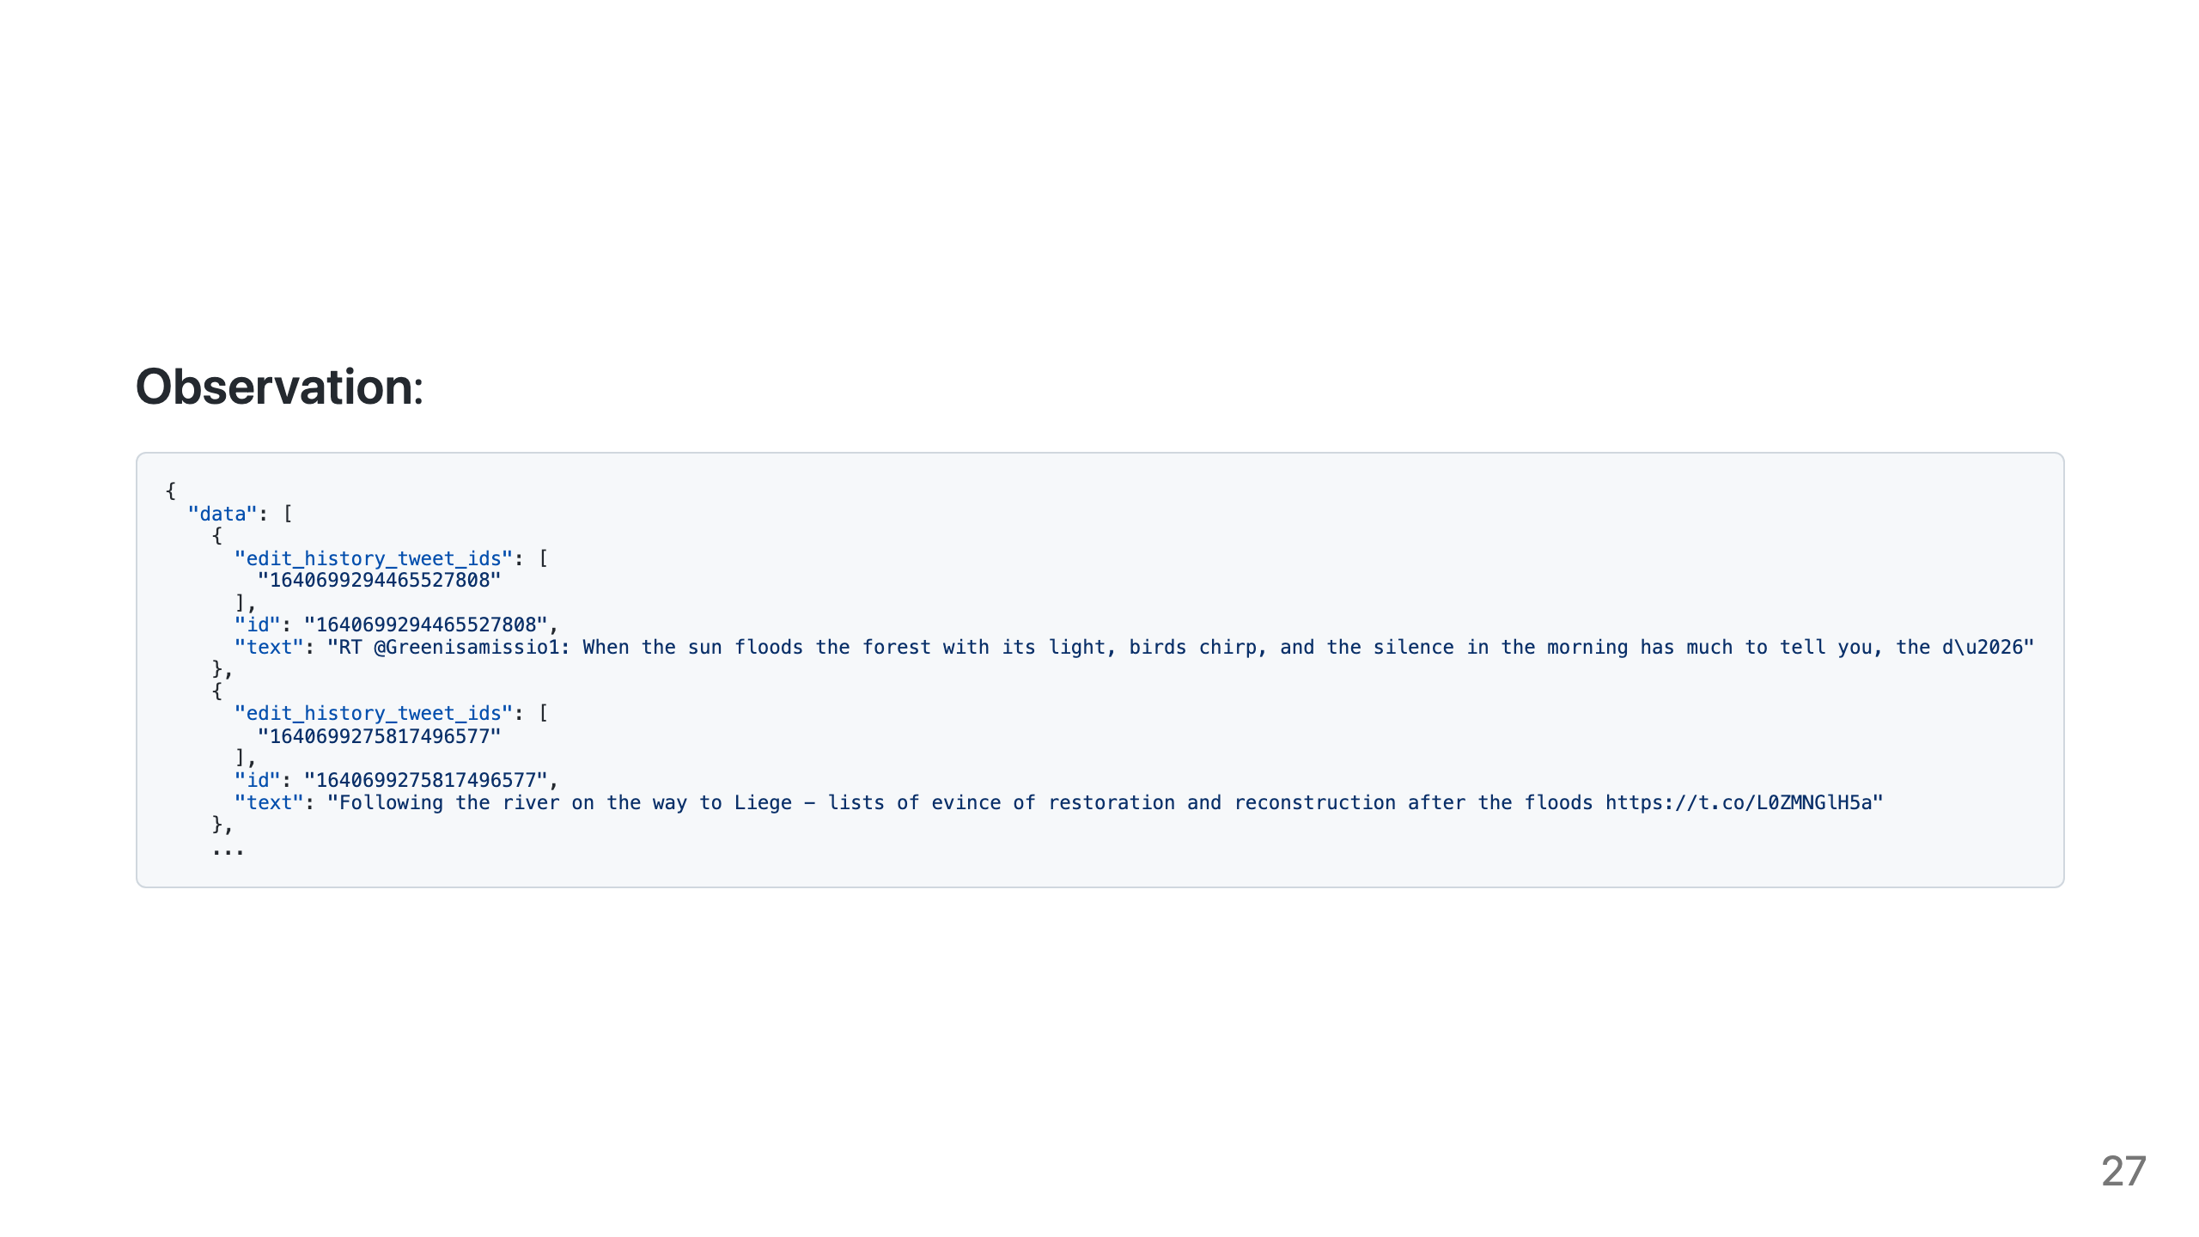
Notes:
And now we have the correct result, just as we asked.

Slide 28
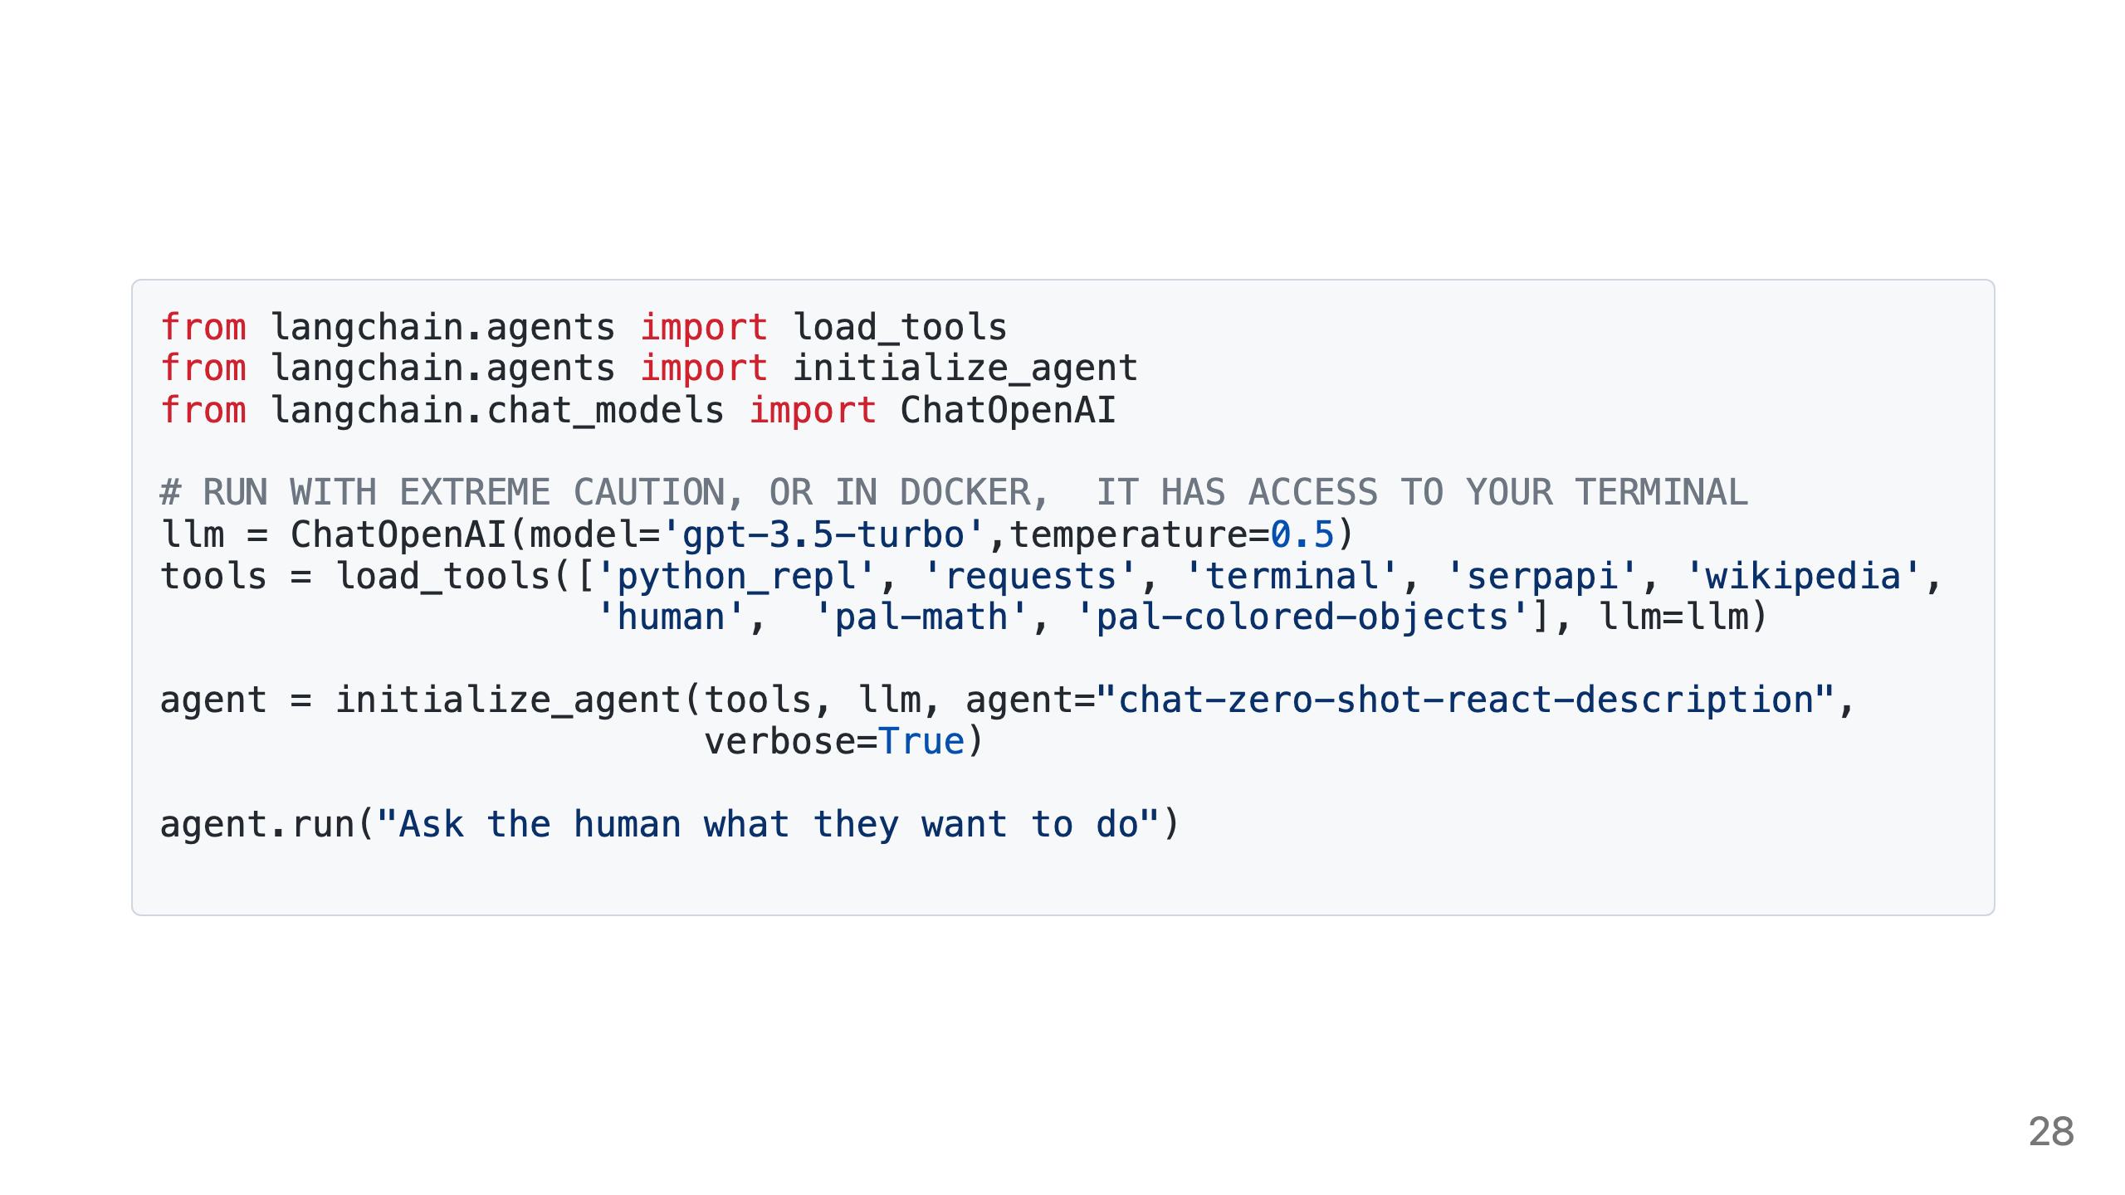
Notes:
The code I used for this is pretty simple with most of the heavy lifting done by LangChain. If you want to see some silliness with paperclips there's another example in this repo where I ask the AI to do the one thing we mustn't ask.

Slide 29
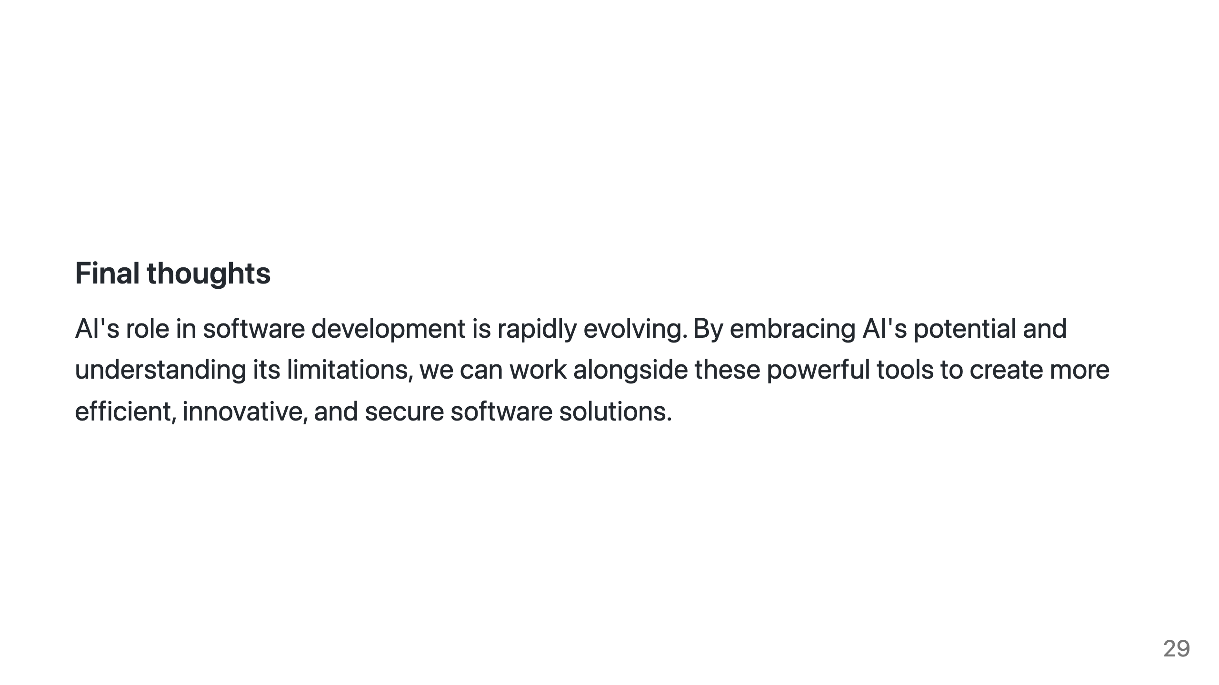
Notes:
AI's role in software development is rapidly evolving, and while it may not replace developers entirely, it will undoubtedly redefine the way we write code. By embracing AI's potential and understanding its limitations, we can work alongside these powerful tools to create more efficient, innovative, and secure software solutions. The journey has just begun, and I believe the key to success is collaboration between humans and AI. As software developers, we should remain curious and open to the possibilities that AI offers, while always maintaining a critical eye on its output. In the end, our collective expertise will drive AI to become an indispensable tool in the software development process.

Slide 30
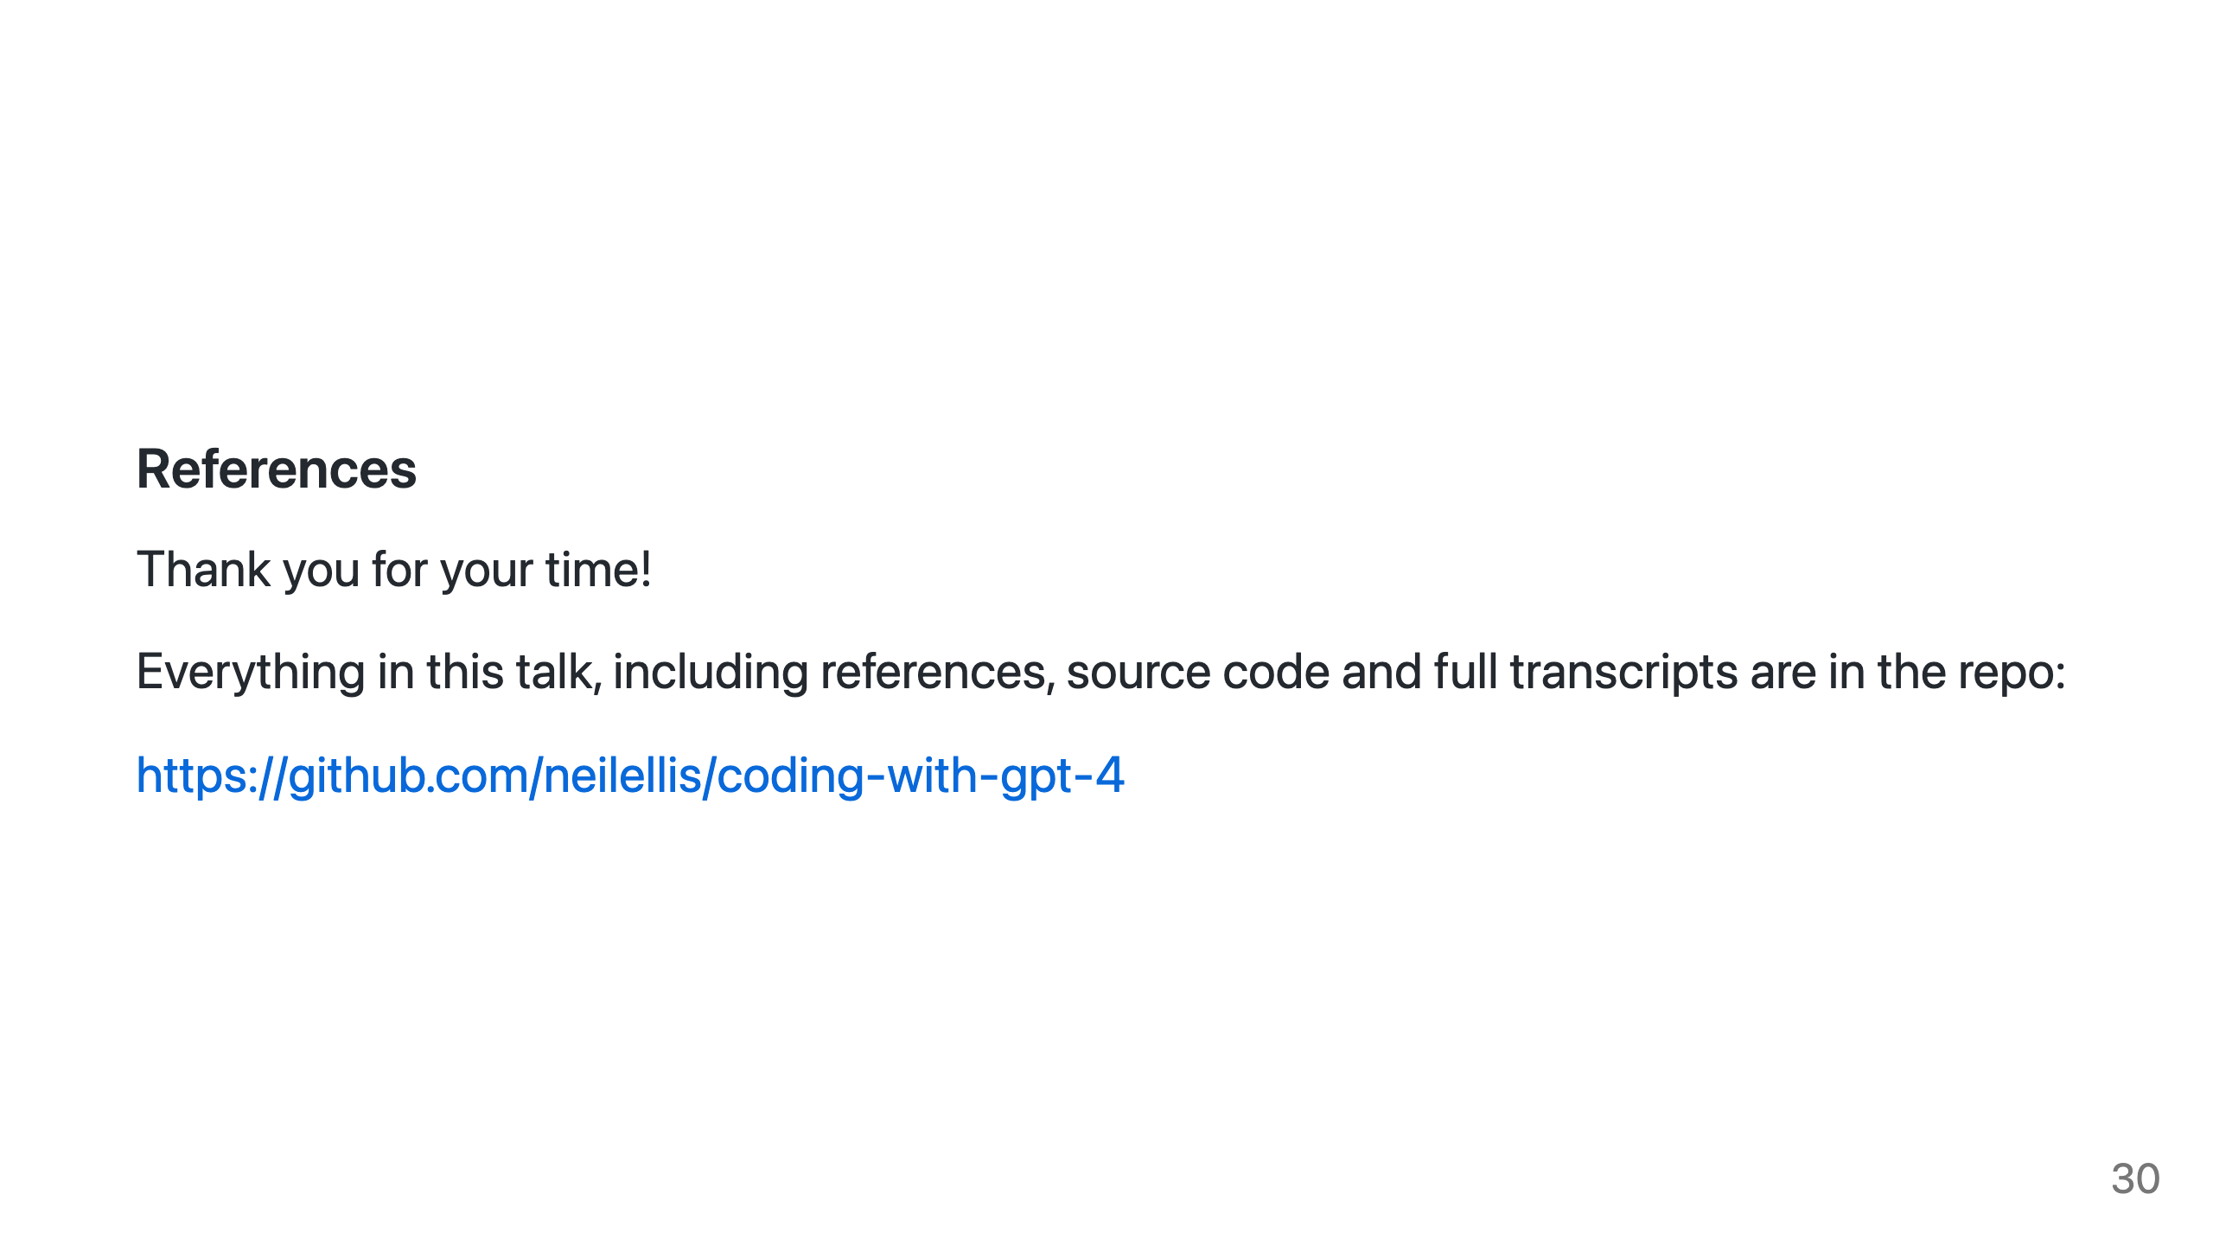
Notes:
Thank you for your time, I hope this short presentation has given you a taste for what we can do with the new generation of AIs. Even if you already played with ChatGPT I urge you to try ChatGPT-4 and if you've used ChatGPT-4 I urge you to play with LangChain. Everything in this talk, including references, source code and full transcripts are in the repo.

